Slide 1

Development of dual-species spin maser of ¹²⁹Xe and ¹³¹Xe toward the EDM measurement
^{A}Kyushu Univ., ^{B}Tokyo Tech., ^{C}RIKEN Nishina Center
K. Tanimoto^{A}, Y. Ichikawa^{A}, S. Tachikawa^{A}, T. Sato^{B}, S. Ando^{A}, Y. Shinohara^{A}, Y. Yamamoto^{A},
H. Nishibata^{A}, S. Go^{C}, A. Takamine^{C}, H. Ueno^{C}, K. Asahi^{C}
Notes:
Hello everyone, my name is Kohei Tanimoto, and I am a first-year master's student at Kyushu University. I will now begin my presentation.

Slide 2
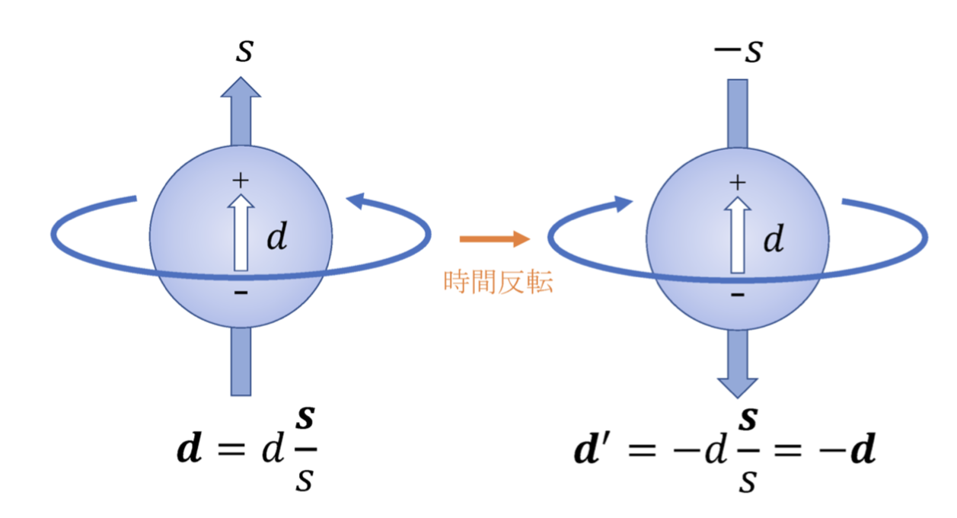


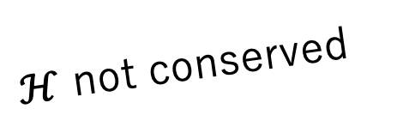

Electric Dipole Moment (EDM)
$ℋ$ not conserved
Time reversal
・EDM violates T-reversal symmetry
・EDM is sensitive to an extra CP violation beyond the Standard Model
$$ℋ=−μ∙B−d∙E$$
$$ℋ′=−μ∙B+d∙E$$
Exp. sensitivity
$$d\sim {10}^{−28}ecm$$
Detection of Frequency difference down to 1 nHz is required assuming E = 10 kV/cm
Spin maser achieves precision by maintaining precession for long periods of time
Spin Maser Details
Notes:
Are you familiar with EDM? EDM stands for Electric Dipole Moment, and it is the focus of our research.
As you can see from this figure, the existence of EDM is closely related to T violation and CP violation.
So, we are conducting EDM exploration to discover new CP and T violation beyond the Standard Model
Therefore, we are planning to deduce EDM through the nuclear spin precession motion.
To achieve our target upper limit for EDM, we require highly precise frequency measurements at the level of 1 nHz.
Spin maser achieves precision by maintaining precession for long periods of time.
Next, let me introduce the details of the spin maser

Slide 3
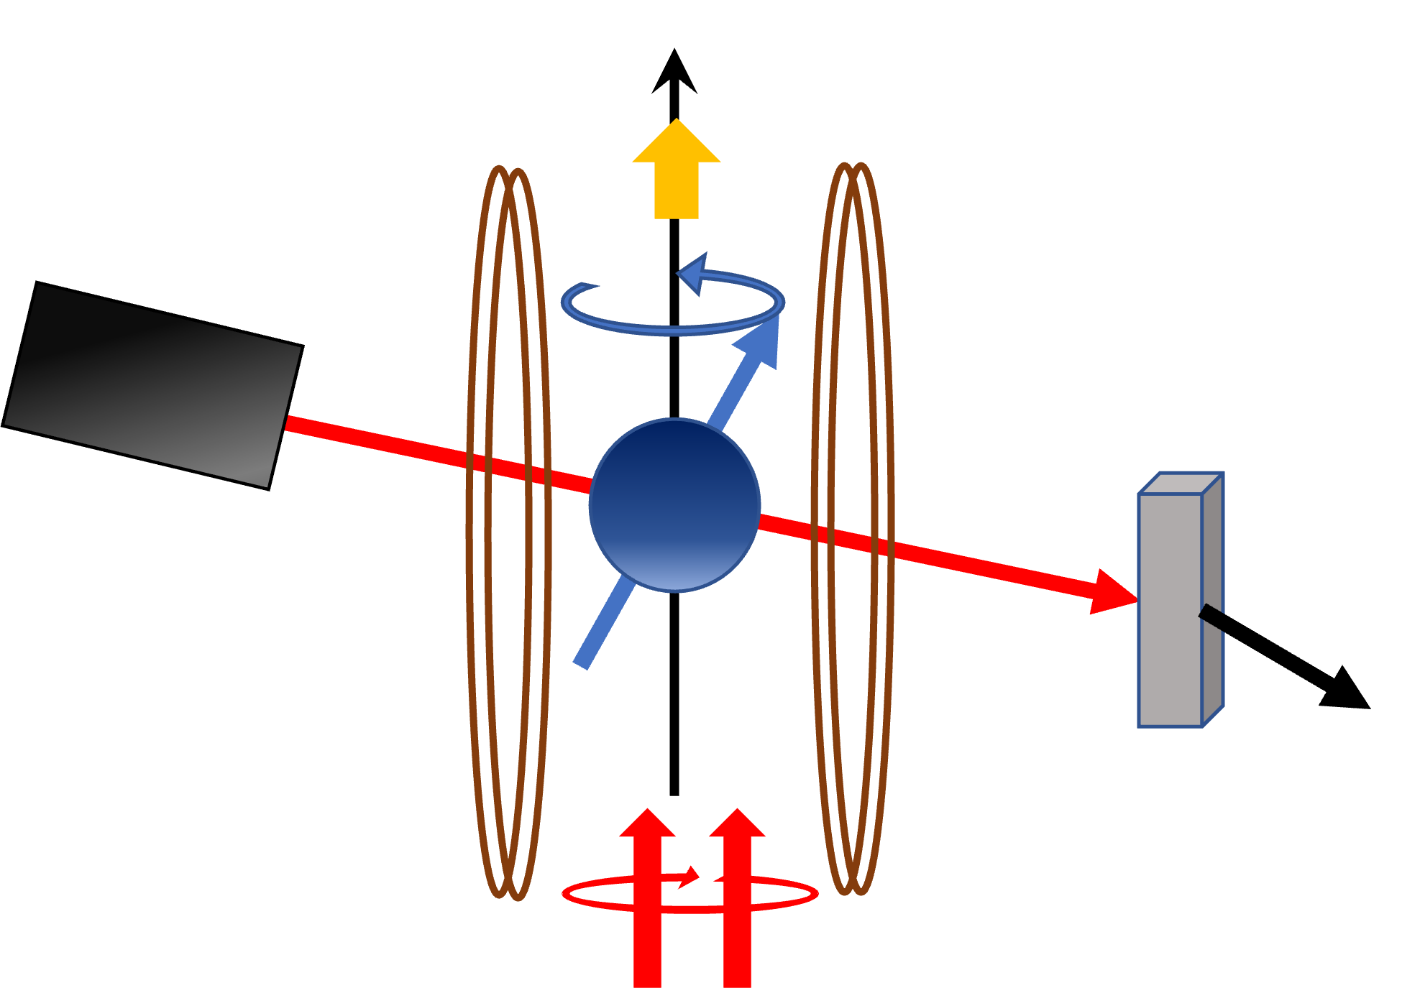
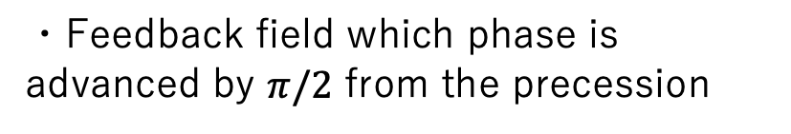
Spin Maser ①
・Optical detection of spin precession of ¹²⁹Xe and ¹³¹Xe
Static magnetic field (〜mG)
・Artificial processing of precession signals to generate feedback field
Feedback coil
Probe Laser
Feedback circuit
・Feedback field which phase is advanced by $π/2$ from the precession
Lock-in detector
Photo detector
Coherent spin precession sustains
Precession phase detection
Pumping Laser
Frequency precision improving by T ^{-3/2}
Notes:
As mentioned earlier, the spin maser is designed to sustain nuclear spin precession for extended periods. To do so, we apply feedback magnetic fields.
First, optically detect spin precession of Xe (ジノン)by probe laser.
Next, The obtained signals are artificially processed to generate feedback fields.
And then, we apply the generated feedback fields which phase is advanced by $π/2$(π over 2) from the precession.
Through this proces, we can maintain coherent spin precession, enabling long-duration measurements. The precision of the spin’s frequency improves with the measurement time raised to the power of – three halves

Slide 4
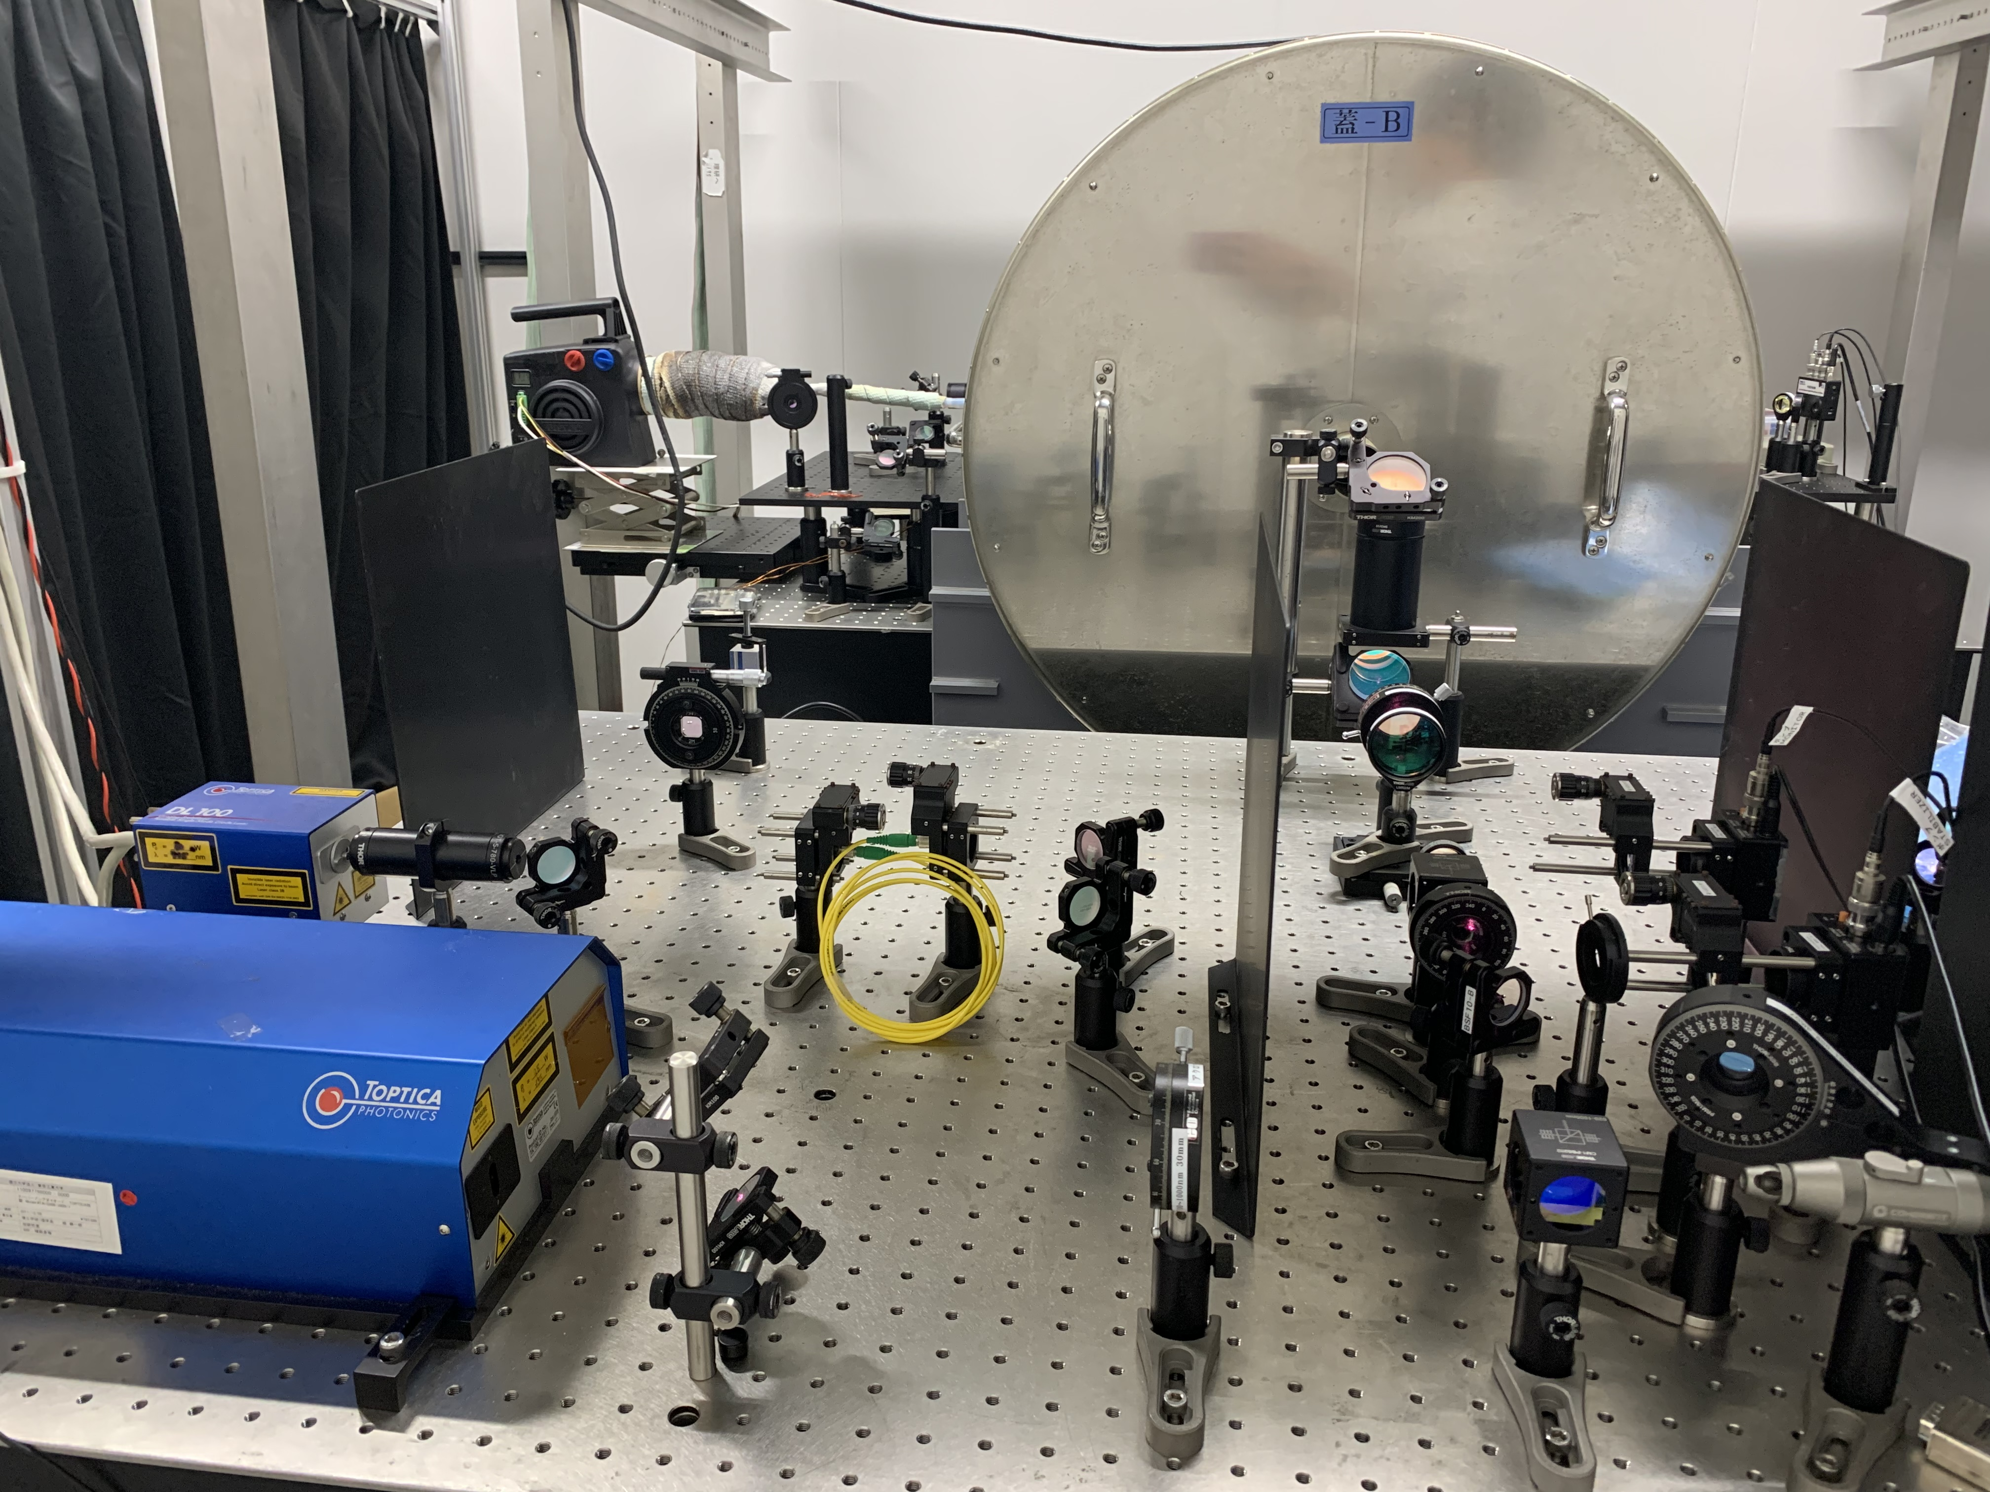
Spin Maser ②
Magnetic shield
Photo detector
Probe laser
Pumping laser
Notes:
This constitutes the actual experimental setup and located in Kyushu University.
These two Laser , probe leser and pumping laser
The glass cell is placed within this three-layer magnetic shield to eliminate the influence of environmental magnetic fields.
The probe laser, after passing through the glass cell, is observed by the photodetector, and then allowing us to optically process.

Slide 5
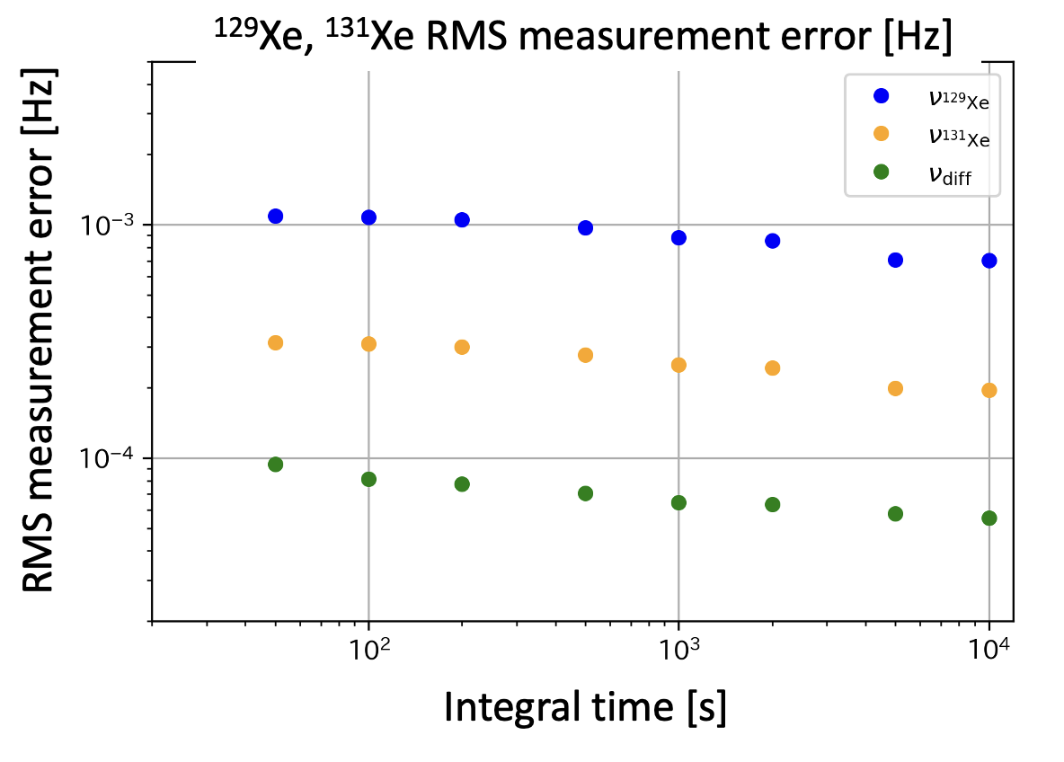
First trial of maser operation
Long-term stability
RMS error
Cf.) 6.15 μHz
55 μHz
T. Sato et al., Phys. Lett. A 382, 588-594 (2018).
S. Ando., Master Thesis, Kyusyu University (2023)
・Stability
To improve
・S/N ratio
Notes:
Next, let me present the results of the first trial of spin maser operation last year
Long-term stability of frequency is important for EDM measurements.
This figure represents the RMS error, The measurement result was 55 μHz.
In previous studies, results approximately 10 times better have been obtained. We are considering stability and signal-to-noise ratio (S/N ratio) as possible factors.

Slide 6
To be improved
Stability
  Stabilize the wavelength and power of the Pumping and Probe Lasers
Improvement of S/N ratio
  Cell with electrodes are necessary for the EDM measurement
  Optimization of cell constitution and fabrication
Notes:
lastly, let me introduce our current efforts that we will be presenting in the poster cession
Regarding stability, we are working on stabilizing the wavelength and power of the lasers. Currently, to achieve stability in the probe laser's, we have introduced DBR (Distributed Bragg Reflector) lasers.
Next, concerning the signal-to-noise ratio (S/N ratio), we are planning to implement a cell with electrodes for actual EDM measurements. And we are working on optimizing the material and fabrication method
Thank you for listening my presentation
If you have found any interest in my research, Please do come and attend my poster presentation. I would be delighted to have you there. Thank you very much.

