Slide 1
Barrier distribution and excitation function measurements of the ⁵¹V + ¹⁵⁹Tb fusion reaction for estimating the optimal reaction energy for the synthesis of element 119
¹Y. Michimoto and ¹S. Sakaguchi for ²nSHE Collaboration
¹Kyushu University,
²ANU, IMP, IPHC, JAEA, Kyushu Univ., Niigata Univ., ORNL, Osaka Univ., RIKEN Nishina Center, Saitama Univ., Tohoku Univ., UTK, and Yamagata Univ
Notes:
Thank you for giving me a chance to talk about my work. The title of my presentation is 「Barrier distribution and excitation function measurements of the ⁵¹V + ¹⁵⁹Tb fusion reaction for estimating the optimal reaction energy for the synthesis of element 119」. I am Yuya Michimoto from Kyushu University.

Slide 2
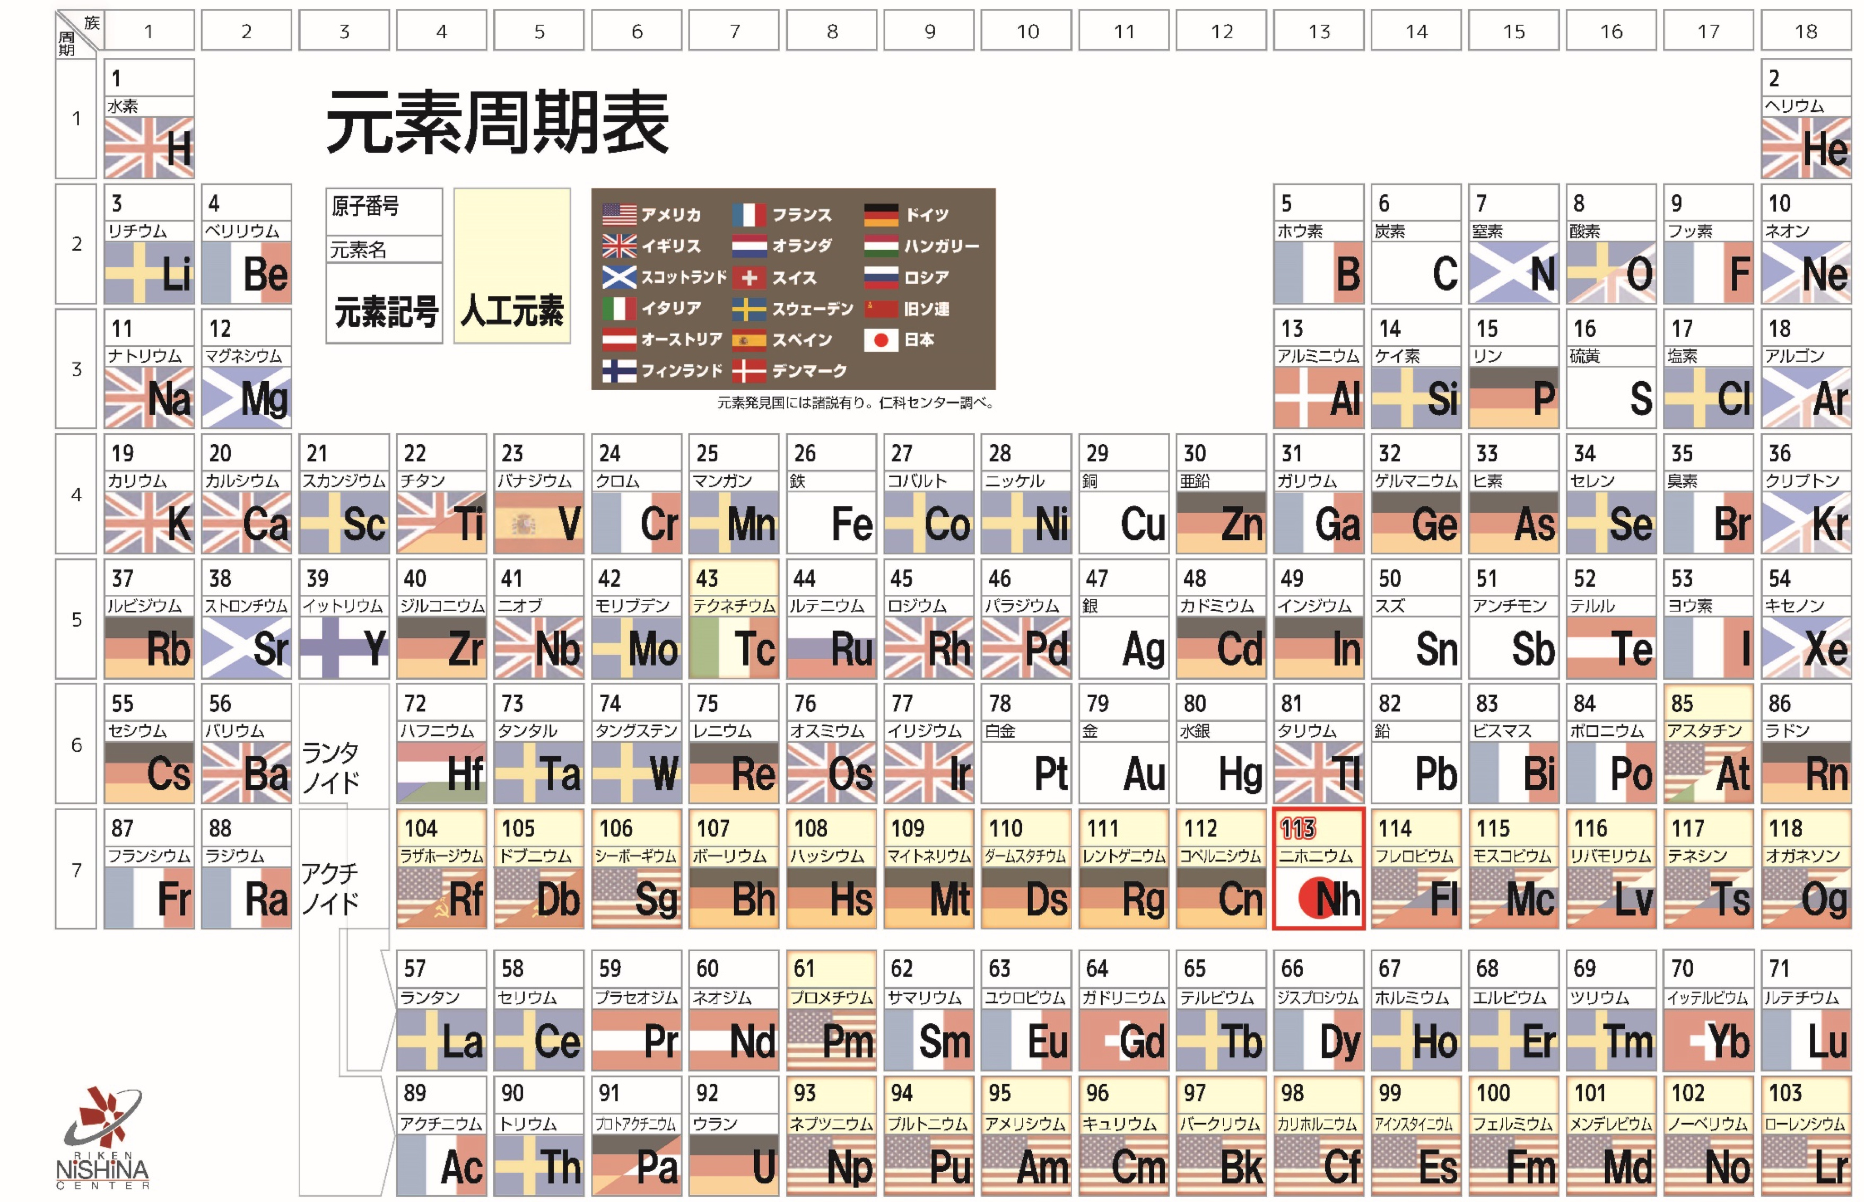
Introduction
Super heavy elements
119
The 8th period
https://www.nishina.riken.jp/113/history.html
Notes:
Let's start with the introduction.
This figure shows the periodic table. Among these, elements beyond actinides are called as “superheavy elements”. Since these elements do not exist in nature, they are synthesized by heavy-ion fusion reactions, which fuse two nuclei together.
Currently, elements up to 118 have been discovered, and experiments to search for new elements in the 8th period are being conducted around the world. We are working on the search for element 119 at RIKEN using ⁵¹V+²⁴⁸Cm fusion reaction.

Slide 3
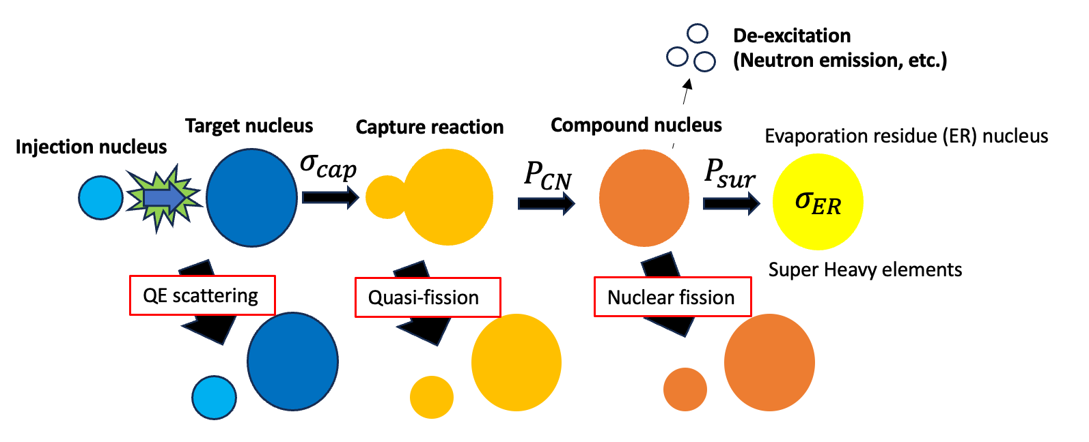
Introduction
⇨ Probability of ER (superheavy nucleus) formation becomes very small.
(If the incident energy deviates from the optimum value by 5%, the probability of ER formation becomes 1/10.)
The incident energy of the beam is the most important parameter of the experimental condition for maximizing the production probability
Notes:
This figure shows the process by which superheavy nuclei are produced. In most cases, quasi-elastic scattering or fission occur, so the probability of evaporation residue being produced is very low. If the incident energy deviates from the optimum value by 5%, the probability of evaporation residue formation becomes one-order of magnitude smaller.
Therefore, the incident energy of the beam is the most important parameter of the experimental condition for maximizing the production probability.

Slide 4
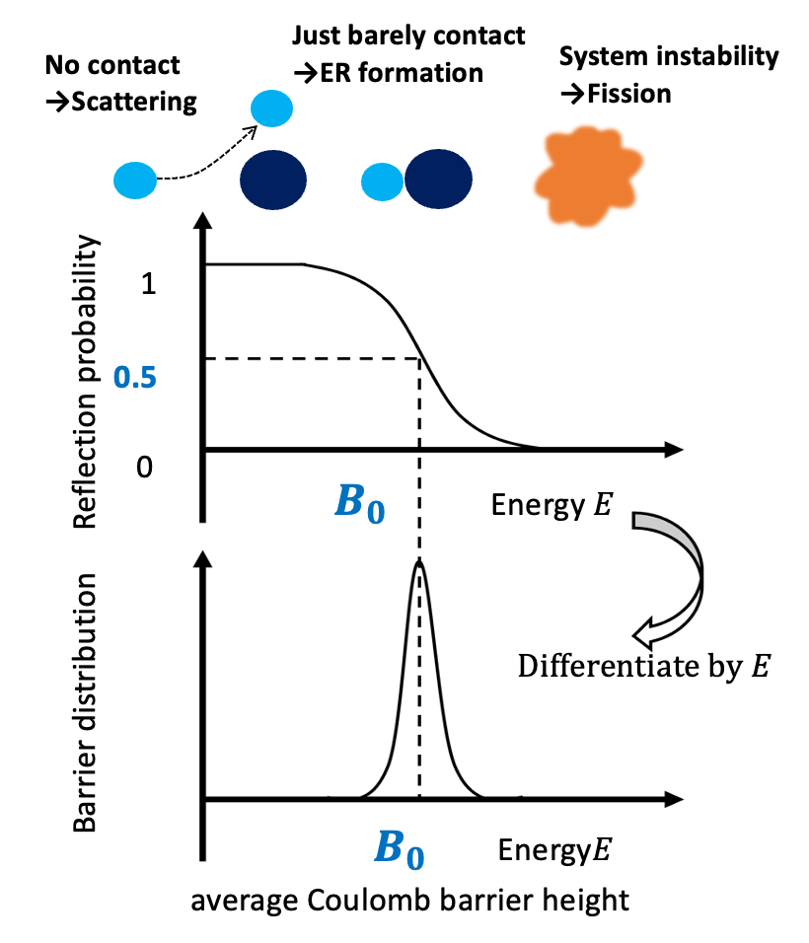
Introduction
Challenge: Difficult to theoretically estimate the optimal incident energy with sufficient accuracy.
A method was developed to estimate the optimum injection energy by measuring the fusion barrier distribution.
[1] T. Tanaka et al., Phys. Rev. Lett. 124, 052502 (2020).
Objective: To validate and improve the accuracy of estimation methods
Notes:
However, it is currently difficult to theoretically estimate the optimal incident energy with sufficient accuracy.
So, a method was developed to estimate the optimum injection energy by measuring the fusion barrier distribution.
If the collision energy between the incident and target nuclei is too low, two nuclei will not collide. If it is too high, the system becomes instable and goes to the fission channel.
So, the optimum incident energy for fusion should be close to the energy with which two nuclei contact very softly. At this energy, the reflection probability is 0.5.
Since it is easy to measure the reflection probability of the quasi-elastic scattering, we can estimate the optimal energy based on this kind of experimental data.
Currently, we use this method to determine the incident energy for element 119 search, but we hope to validate and improve the accuracy of estimation methods as much as possible.

Slide 5
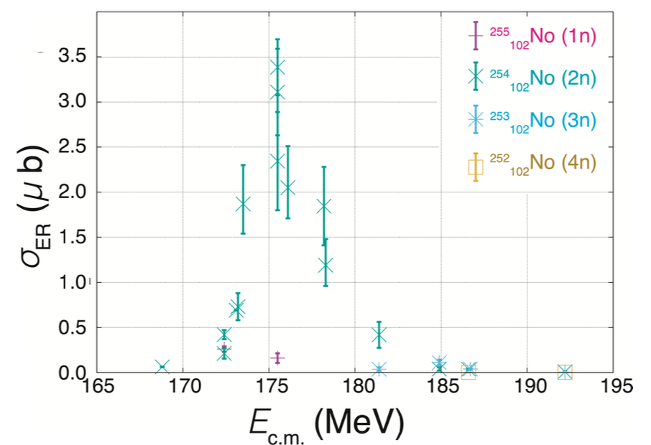
Introduction
Example of barrier distribution data
Example of excitation function data
①Measurement
for ⁵¹V+¹⁵⁹Tb
(¹⁵⁹Tb has similar $β$₄ to ²⁴⁸Cm)
[2] T. Tanaka et al Kyushu University Doctoral Dissertation (2019).
②Comparison
B₀
E_{opt}
Optimum energy estimated from the barrier distribution measurement
Experimentally obtained optimum energy
Notes:
So, in this research, we measured the barrier distribution and excitation functions of ⁵¹V + ¹⁵⁹Tb and compared the experimentally obtained optimum energy and the one estimated from the barrier distribution measurement.
The reason to choose the ¹⁵⁹Tb for the target is because it has a similar quadrupole deformation parameter to ²⁴⁸Cm.

Slide 6
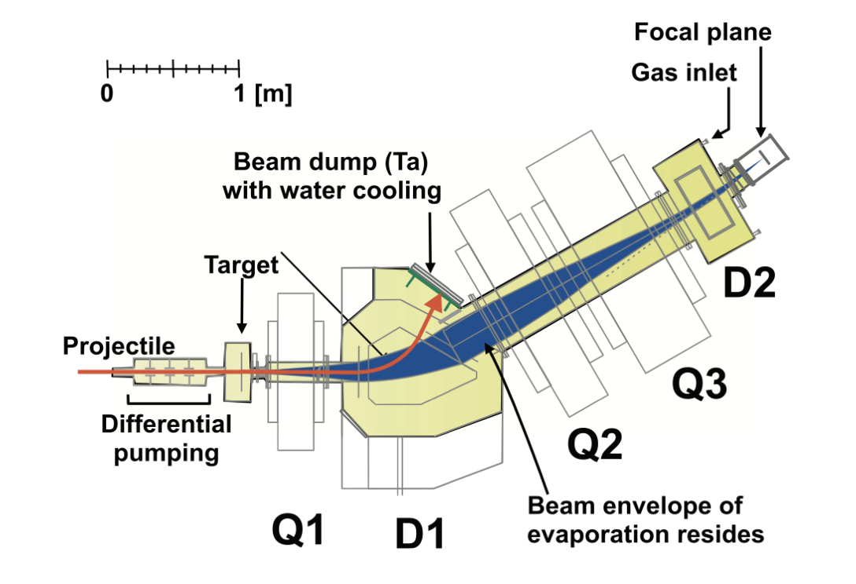
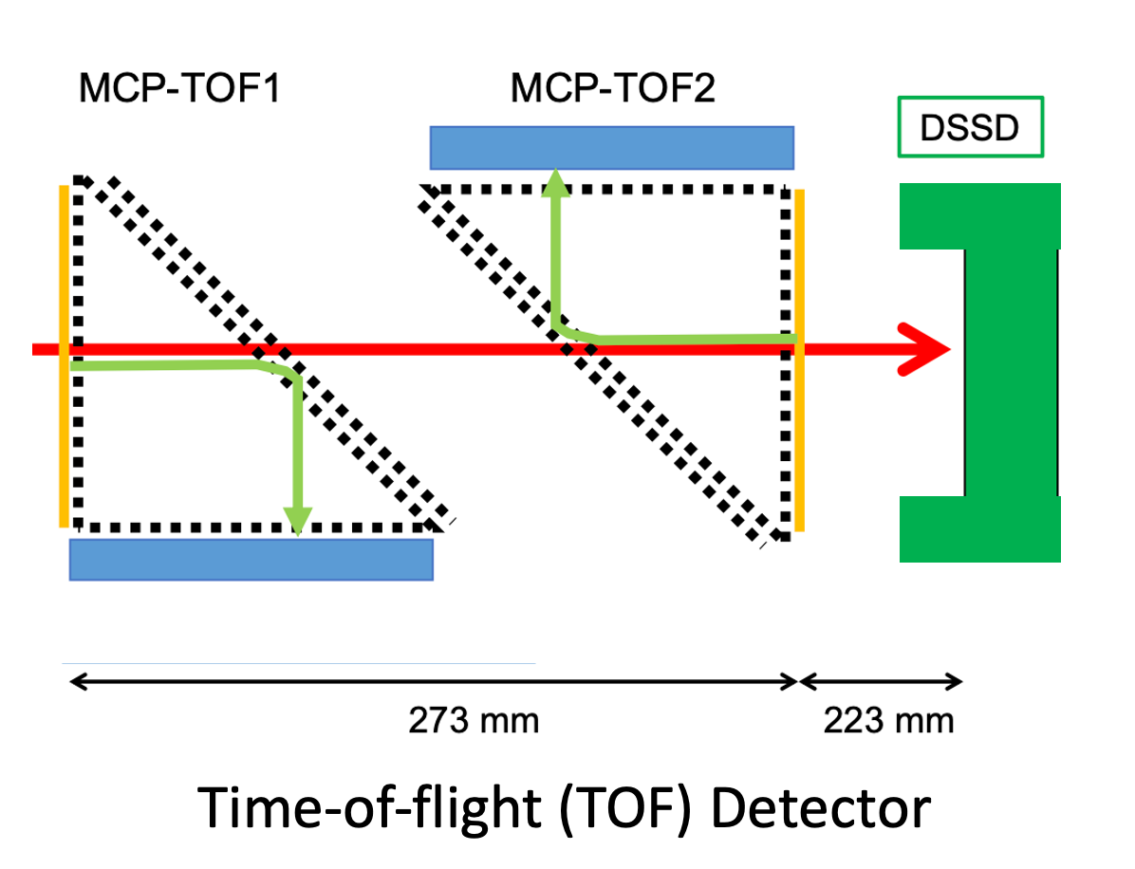
Experimental setup
GARIS-III
¹⁵⁹Tb
⁵¹V
Barrier distribution (E_{beam}=130-180 MeV step:2MeV) → ¹⁵⁹Tb
Excitation function (E_{beam}= 205-250 MeV step:5MeV) → ER (evaporation residue)
Notes:
Next, I describe the experimental setup.
In this experiment, the beam was V and the target was Tb.
This figure shows GARIS3 at RIKEN, by applying a magnetic field, particles can be bent and only the particles of interest can be measured.
In the barrier distribution measurement, Tb was measured with the focal plane detectors, and in the excitation function, evaporation residue was measured.

Slide 7
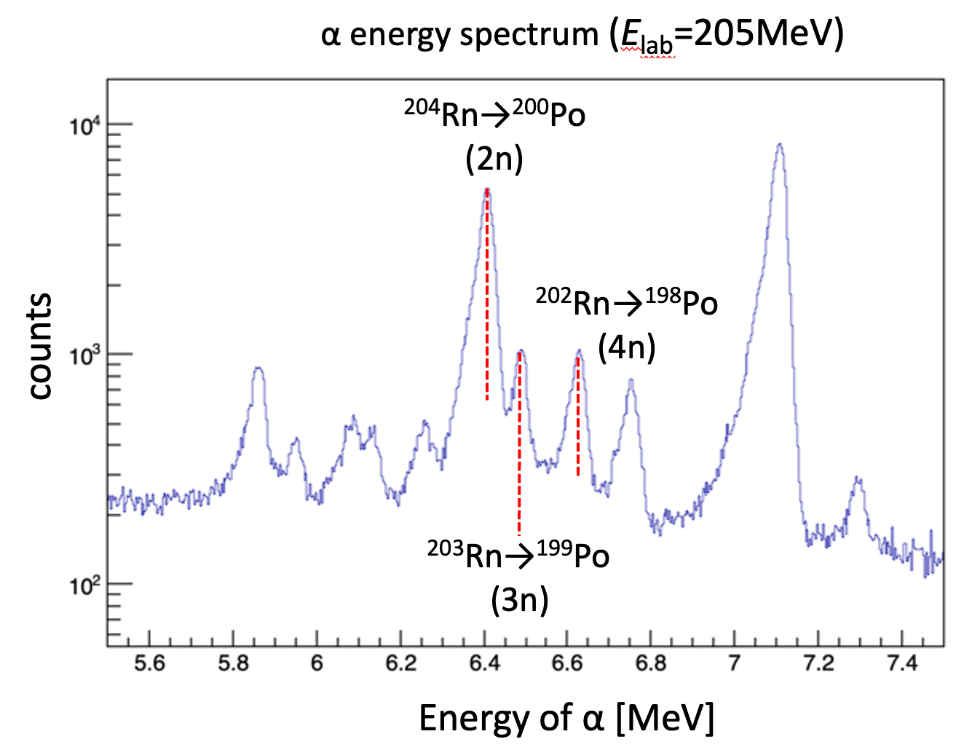
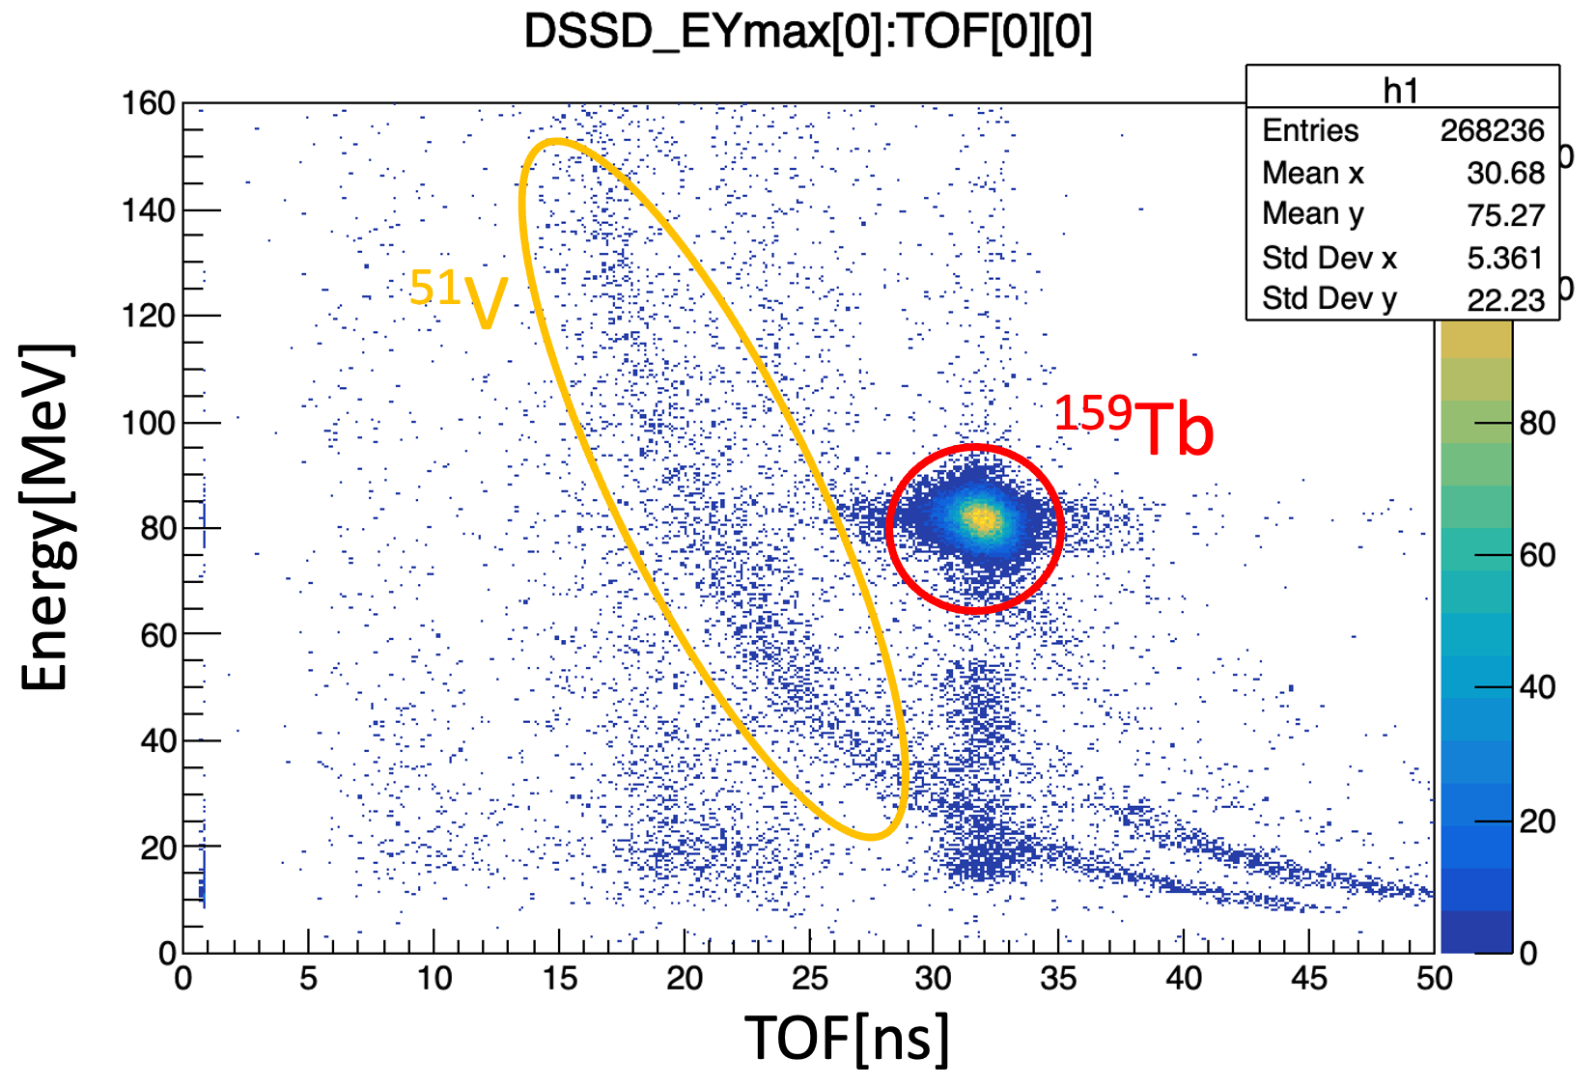
Data analysis
Barrier distribution
Excitation function
Particle identification
Quasi-elastic scattering cross section
Differentiate by E
Barrier distribution
αenergy
Channel ID (2n,3n,4n…)
ER cross section $σ_{ER}$
Excitation function $σ_{ER}(E)$
Notes:
（時間がないと思うので、このページはチラ見せして”I do not have much time, so I skip the data analysis.”と言って次にいきましょう）
Next, I describe the data analysis.
In the barrier distribution measurement, recoil particles were identified based on the correlation between kinetic energy and time of fright.
By measuring the number of Tb, the quasi-elastic scattering cross section is derived.
Then, by differentiating it by energy, the barrier distribution is derived..
In the excitation function measurement, we first identified the evaporation residue from the alpha decay energy.
And by counting the events, we obtain evaporation residue cross sections.
From the data with different incident energies, we obtain the excitation function.

Slide 8
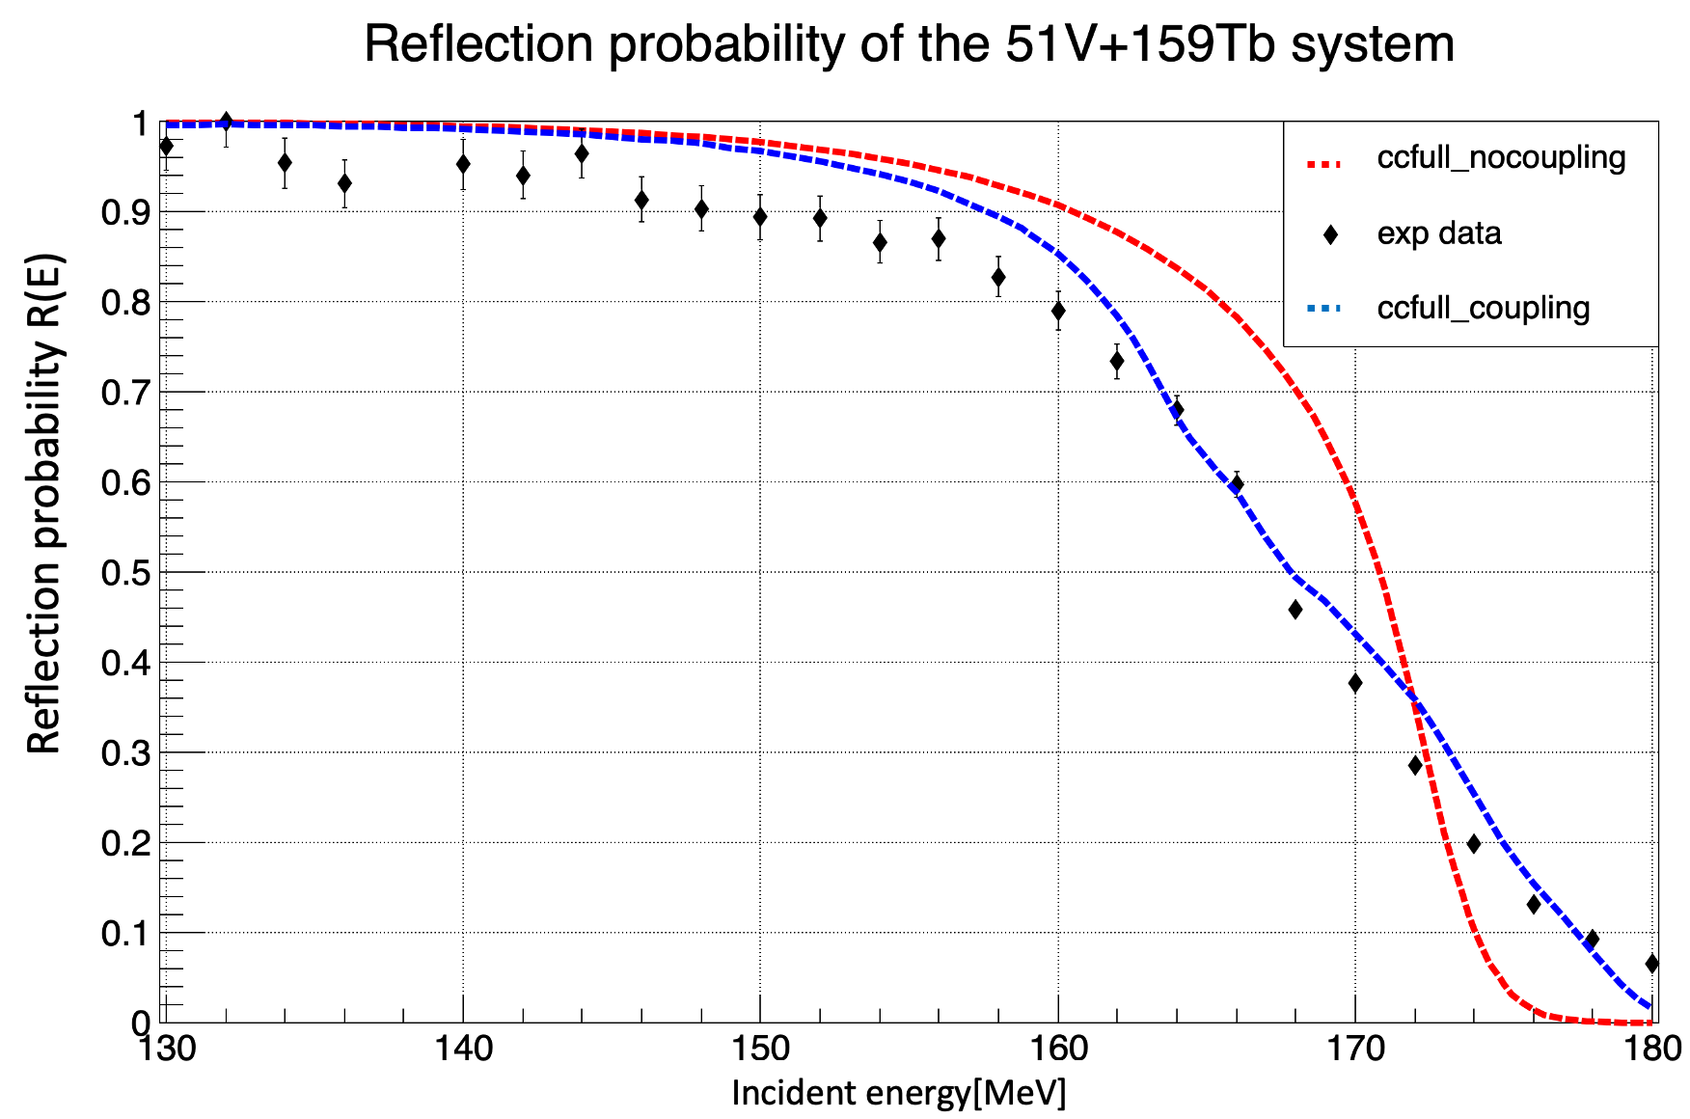
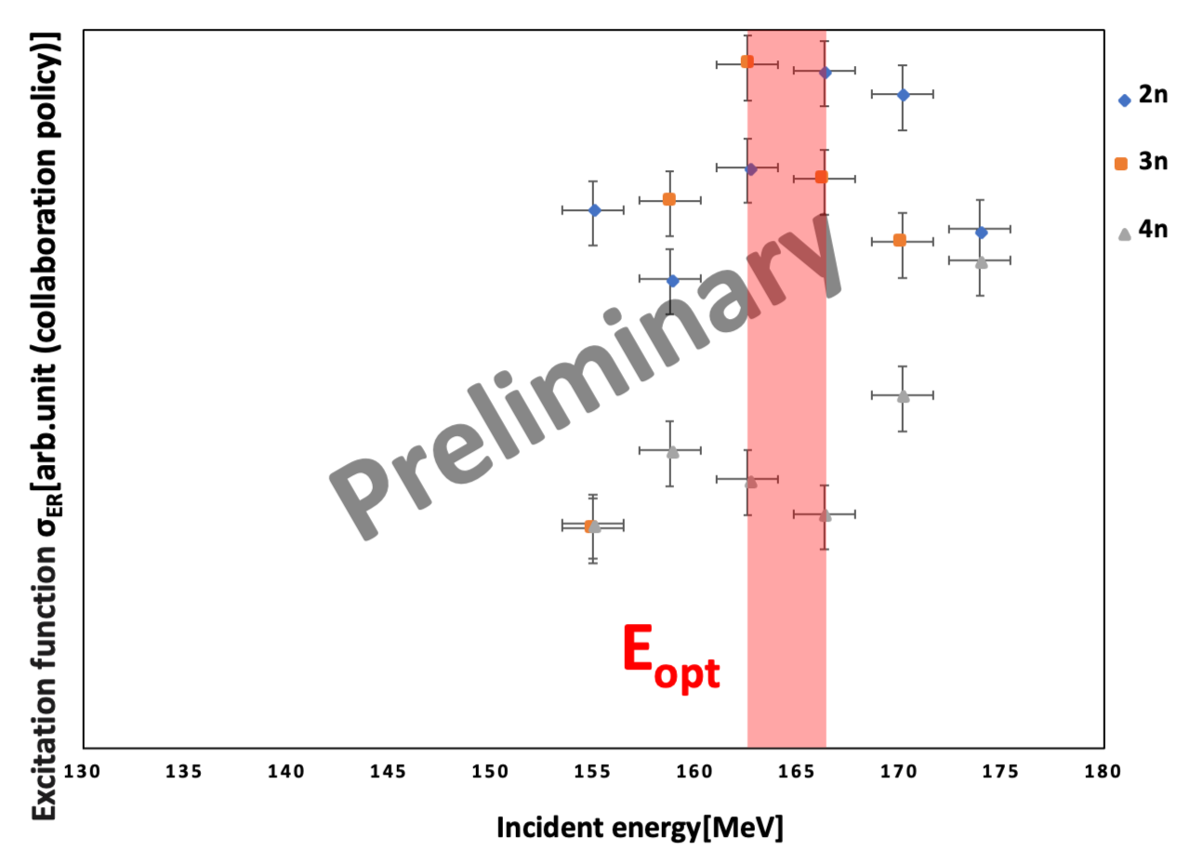
Results
The average barrier height is derived as
B₀(R(E)=0.5)$\sim$168 MeV
Preliminary
From the excitation function results,
E_{opt} = 162-166 MeV
B₀
Agree with an accuracy of a few MeV.
Notes:
Next, I describe the results.
The upper figure shows a reflection probability as a function of the incident energy. The bottom figure shows the excitation function.
And the horizontal axis is the incident energy in both cases.
The average barrier height is derived as about 168MeV.
From the excitation function results, the energy at which the cross section maximum is around 162 to 166 MeV.
These results show agreement with an accuracy of a few MeV.
But since these are the very preliminary data, we need to work on more detailed analysis in the future.

Slide 9
Summary・Future outlook
The fusion barrier distribution and the excitation function were measured in the ⁵¹V+¹⁵⁹Tb system at RIKEN using GARIS-III separator.
The average barrier height and the optimum energy (peak of the excitation function) were found to be in agreement within a few MeV.
Since these are very preliminary results, more detailed analysis is now on going.
Notes:
時間が30秒オーバー程度に収まっていれば読んで最後に”Thank you for your kind attention.”と言って締める。
既に5:30を経過していたら “This is the summary. Thank you for your kind attention.”と言って締める。

Slide 10
Notes:
Thank you for giving me a chance to talk about my work. The title of my presentation is 「Barrier distribution and excitation function measurements of the vanadium51 and terbium159 fusion reaction for estimating the optimal reaction energy for the synthesis of element 119」. I am Yuya Michimoto from Kyushu University.
Let's start with the introduction.
This figure shows the periodic table. Among these, elements beyond actinides are called as “superheavy elements”. Since these elements do not exist in nature, they are synthesized by heavy-ion fusion reactions, which fuse two nuclei together.
Currently, elements up to 118 have been discovered, and experiments to search for new elements in the 8th period are being conducted around the world. We are working on the search for element 119 at RIKEN using vanadium51 and curium248 fusion reaction.
This figure shows the process by which superheavy nuclei are produced. In most cases, quasi-elastic scattering or fission occur, so the probability of evaporation residue being produced is very low. If the incident energy deviates from the optimum value by 5%, the probability of evaporation residue formation becomes one-order of magnitude smaller.
Therefore, the incident energy of the beam is the most important parameter of the experimental condition for maximizing the production probability.
However, it is currently difficult to theoretically estimate the optimal incident energy with sufficient accuracy.
So, a method was developed to estimate the optimum injection energy by measuring the fusion barrier distribution.
If the collision energy between the incident and target nuclei is too low, two nuclei will not collide. If it is too high, the system becomes instable and goes to the fission channel.
So, the optimum incident energy for fusion should be close to the energy with which two nuclei contact very softly. At this energy, the reflection probability is 0.5.
Since it is easy to measure the reflection probability of the quasi-elastic scattering, we can estimate the optimal energy based on this kind of experimental data.
Currently, we use this method to determine the incident energy for element 119 search, but we hope to validate and improve the accuracy of estimation methods as much as possible.
So, in this research, we measured the barrier distribution and excitation functions of vanadium51 and terbium159 and compared the experimentally obtained optimum energy and the one estimated from the barrier distribution measurement.
The reason to choose the terbium159 for the target is because it has a similar quadrupole deformation parameter to curium248.
Next, I describe the experimental setup.
In this experiment, the beam was vanadium and the target was terbium.
This figure shows GARIS3 at RIKEN, by applying a magnetic field, particles can be bent and only the particles of interest can be measured.
In the barrier distribution measurement, terbium was measured with the focal plane detectors, and in the excitation function, evaporation residue was measured.
I do not have much time, so I skip the data analysis.
Next, I describe the results.
The upper figure shows a reflection probability as a function of the incident energy. The bottom figure shows the excitation function.
And the horizontal axis is the incident energy in both cases.
The average barrier height is derived as about 168MeV.
From the excitation function results, the energy at which the cross section maximum is around 162 to 166 MeV.
These results show agreement with an accuracy of a few MeV.
But since these are the very preliminary data, we need to work on more detailed analysis in the future.
Thank you for your kind attention.

