Slide 1

Reconstruction of
³³Mg → ³³Al decay scheme
Kyushu University
Y. Yamamoto, S1840 COLLABORATION
Kyushu University
Yosuke Yamamoto
Notes:
I am Yosuke Yamamoto, from Kyushu University.
I would like to give a short presentation for my poster.
I will be presenting about the topic of "Reconstruction of Magnesium-33 to Aluminum-33 decay scheme.

Slide 2
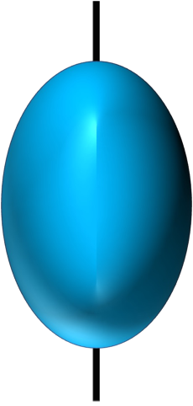
Structure of neutron-rich N〜20 nuclei
General nuclei
around the magic number
Island of inversion
Deformation
Stable and Spherical
Our group studied the neutron-rich Al nuclei located on the northern boundary of this nuclear region.
Present work：³³Al
Notes:
Let me start with physics motivation.
The neutron-rich nuclei around the magic number, N=20, has a region called the island of inversion.
This region has a large axisymmetric deformation in the ground state, contrary to the finding of stable nuclei that are stable and spherical in the ground state near the magic number.
To unravel the mechanism of their appearance, our group studied the neutron-rich Aluminum nuclei located on the northern boundary of this nuclear region.
In the present work, we performed an experiment to investigate the level scheme of Aluminum-33, by using beta-decay of Magnesium-33.

Slide 3
Setup
RI beam
Facility：ISAC-I, TRIUMF
Primary beam：proton 500 MeV
Intensity：20 μA
Target：UCx
RI beam：³³Mg
Energy：30 keV
Purity：〜100 %
Detectors
Ge detectors：8
Plastic scintillators： 10
Low-energy neutron
detectors (< 1 MeV)：6
High-energy neutron
detectors (> 1 MeV) ：2
Notes:
The experiment was performed a TRIUMF in Canada.
This figure shows the experimental setup.
The Magnesium-33 was produced by the target fragmentation reaction with 500-MeV proton beam on UCx target.
The gamma and beta rays were detected by eight Germanium detectors and ten plastic scintillators.

Slide 4
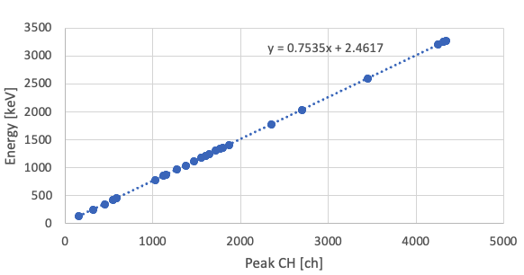
Energy calibration
2. Calculate residuals.
³³Mg → ³³Al： γ > 3000 keV
Standard source：⁵⁶Co, ⁶⁰Co, ¹⁵²Eu
γ Energy：121 – 3548 keV
Fit with a linear function.
3. Use Two fitting functions.
Notes:
Let me show a part of analysis, energy calibration of Germanium detectors.
In the beta decay of Magnesium-33, high energy gamma rays above 3000 keV are expected to be emitted.
So, we used these three standard sources to cover the energy range from 100 to 3500 keV.
First, I created a graph of peak channels versus energies of gamma-rays from these sources and fitted them with a linear function.
Next, I calculated the residuals from first graph, and created second graph.
In second graph, I found non-linearity around 1000 keV.
Therefore, I used two linear fitting functions for energies above and below 1000 keV.
The results are shown in the third graph, which indicates that the residuals decreased, and the accuracy of the energy calibration has improved.

Slide 5
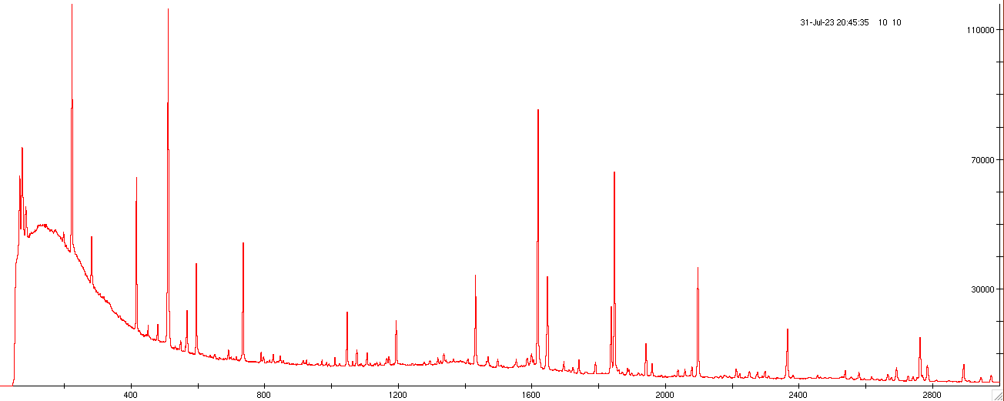
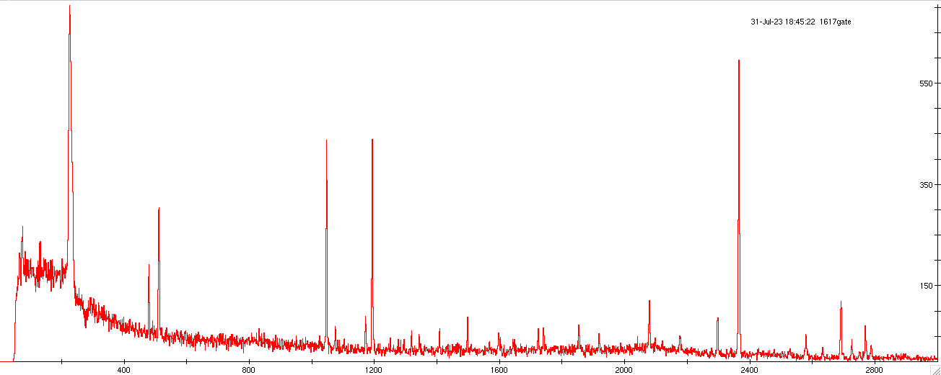
γ-γ analysis
γ-single
1618
★：³³Mg → ³³Al γ-rays
★：Coincidence γ-rays
Decay scheme
New level
New transition
Revised transition
1618 keV Gate
Notes:
Next, I conducted gamma-gamma analysis to construct a decay scheme.
The graph above represents the detected single gamma-rays in experiment and green stars indicate known gamma-rays from Aluminum-33.
The graph below shows the result of applying a gate to the 1618 keV peak.
The red stars represent gamma-ray peaks from Aluminum-33 that are coincident with the 1618 keV gamma-ray.
This graph allowed me to identify the gamma-rays that are in cascade with the gated peak.
By this analysis, I was able to construct the decay scheme shown in this figure.

Slide 6
Poster contents
Island of Inversion
Experimental Setup
Energy Calibration
γ-γ Analysis and Decay Scheme Construction
Future out look
Notes:
In my poster session, I will present a detailed explanation of the these key topics.
I invite all interested participants to visit my poster.
Thank you. for your attention.

