Slide 1
Performance and Geant4 simulation of the upgraded focal plane polarimeter 2nd-FPP
Yusuke Tanaka
Department of Physics, Kyushu University
Notes:
My name is Yusuke Tanaka. I’m from Kyushu University. I’d like to talk about “Performance and Geant4 simulation of the upgraded focal plane polarimeter 2nd-FPP”.
______________________________________________________________________________________________________________________ポラ’リ’メーター

Slide 2
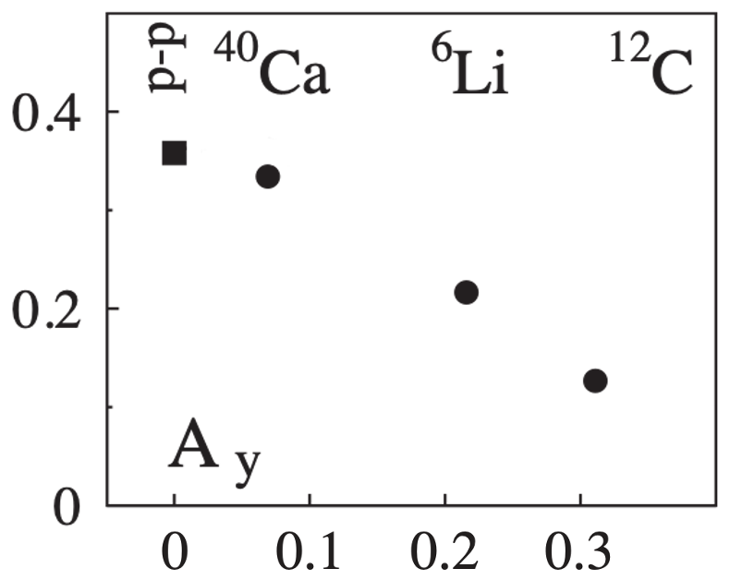
Background
Nuclear medium effect (in the dense nuclear field)
・The reduction of $A_{y}$
-65%
Our group
Determine the NN int. in the nuclear field
experimentally
T. Noro et al., PRC 77, 044604 (‘08).
…measure the polarization transfers to recoil protons
Our project
Developing 2nd-FPP (Focal Plane Polarimeter)
Notes:
First, let me explain our physics motivation.
Our group is interested in the nuclear medium effects in the dense nuclear field.
One clear medium effect is the reduction of proton-proton analyzing power Ay in the nuclear field as shown in the right figure.
In the carbon nucleus, the effective density is about 1/3 (one-third) of the saturation density, and the analyzing power is reduced by about 2/3 (two-third).
In order to investigate the medium effects in more detail, we plan to determine the nucleon-nucleon interaction in the nuclear field experimentally.
For this purpose, we must measure the polarization transfers to recoil protons.
Thus, we have been developing a proton polarimeter called 2nd-FPP for recoil protons.

Slide 3
Principle of Polarimeter
Use the asymmetry of p-C elastic scattering
Position detector
Asymmetry: $ε$ observed experimentally
$$Y_{L}$$
$$Y_{R}$$
$$ε=\frac{Y_{L}−Y_{R}}{Y_{L}+Y_{R}}=pA_{y}$$
$$θ$$
$$θ$$
Ex.)
$A_{y}$=0.6
If $A_{y}$=0.6...
80%→right, 20%→left
Scatterer
¹²C
$$ε=\frac{1−4}{1+4}=−\frac{3}{5}=−0.6$$
$ε=−0.3$ (observed)
Ex.)
Ex.) $p$=-1
⇒ $p=−0.5$
Purpose
Obtain effective analyzing power $A_{y}$_{:eff}
Notes:
Next, let me talk about principle of polarimeter.
We use the spin-dependent asymmetry of proton-Carbon elastic scattering.
The experimentally observed left-right asymmetry is the product of the proton polarization p and the analyzing power Ay of this reaction like this.
For example, as shown in this figure, let’s suppose all protons are spin-down, and thus the polarization is -1.
If Ay is 0.6, 80% protons will be scattered to the right and 20% protons will be scattered to the left, and thus the asymmetry becomes -0.6.
Therefore, if the observed asymmetry is -0.3, we can find that the proton polarization is -0.5, half of this case.
In this way, if the analyzing power Ay is known, we can obtain the polarization p by measuring the left-right asymmetry.
The purpose of my experiment is to obtain this Ay, called the effective analyzing power.

Slide 4
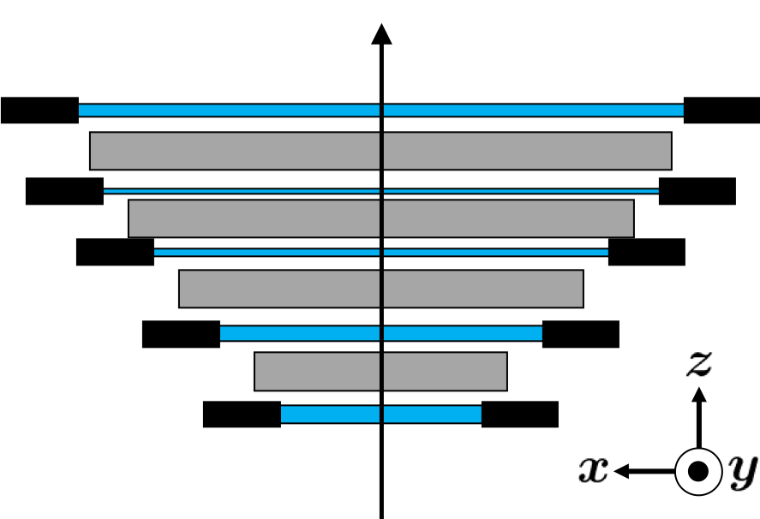
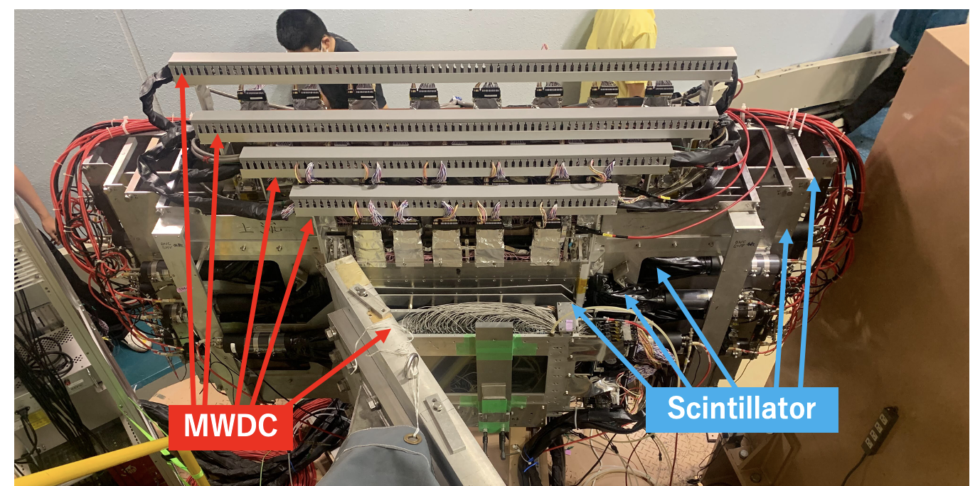
Experimental Setup
2nd-FPP(Focal Plane Polarimeter)
・Scintillator ✕ 6 planes
・MWDC ✕ 5
→ Improve position + angle resolution
veto
Scintillator
NEW
MWDC
Beam
RCNP: Inject polarized proton ($P≅1$) into 2nd-FPP
c.f. Research Center for Nuclear Physics, Osaka University
Notes:
These figure and photo show our proton polarimeter 2nd-FPP.
This polarimeter consists of six scintillator planes and five wire chambers.
The proton-carbon elastic scattering in the plastic scintillator acts as the polarization analysis, and the left-right asymmetry is measured by tracking the scattered protons by the wire chambers.
In this experiment, the injected protons to the polarimeter were the elastically scattered protons on carbon at 45 degrees, whose polarization was about 1.

Slide 5
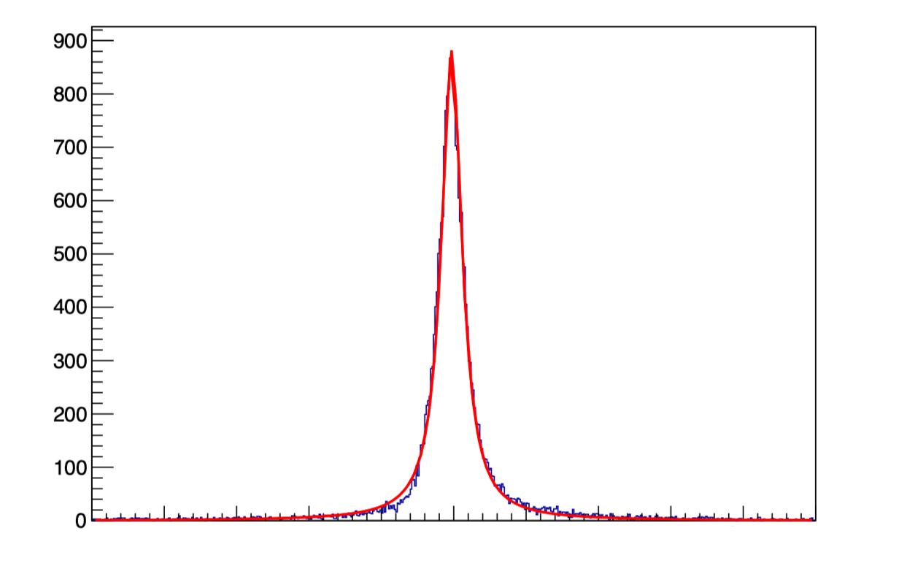
Results
Improved position resolution
: Position detection
MWDC
FWHM
0.34 [mm]
Yield [counts]
Track proton
Scintillator
$−$5
$−$4
$−$3
$−$2
$−$1
0
1
2
3
4
5
MWDC
the position of the particle passage [mm]
Resolution：0.34 mm
c.f. 26.6 mm w/Scintillator
Track proton
→improved by two orders of magnitudes
proton
Notes:
As the results, first I’ll show you the improvement of position resolution by introducing the wire chambers.
If we use the information from plastic scintillator only, the position resolution was about 30 mm.
By using the wire chamber information, we improved the resolution by two orders of magnitudes, and the final value is about 0.3 mm.

Slide 6
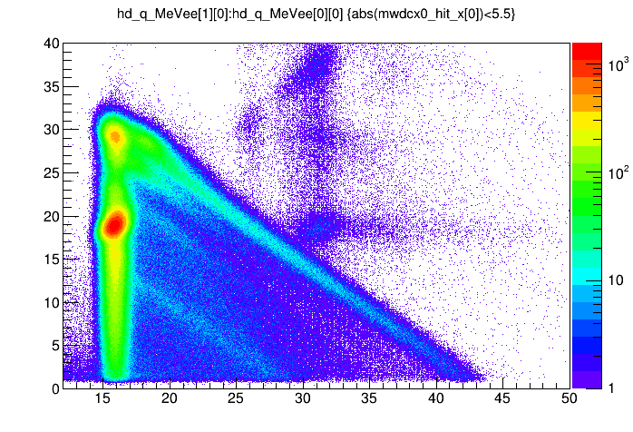
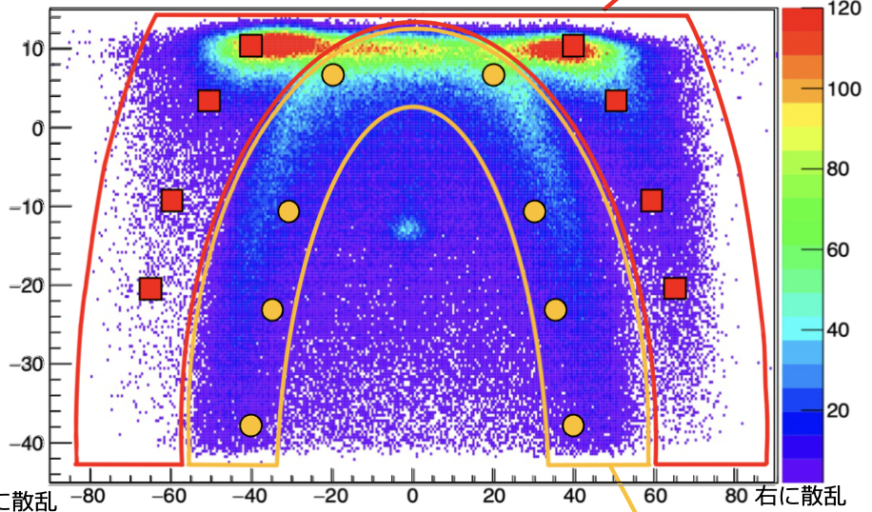
Results
Separate p-C and p-p elastic scattering
2nd. vs 1st. Scintillator (Energy loss)
Energy difference vs Scattering angle
Total energy loss = Incident energy
60°
30°
Energy difference [MeVee]
Energy loss (2nd.) [MeVee]
p-p
p-C
Scattering angle [deg.]
Energy loss (1st.) [MeVee]
Notes:
Next, I’ll show you the separation of elastic scatterings on carbon and hydrogen in the scintillator.
Since the both events lost the same energy in the polarimeter as shown in the left, we could not separate them by using the energy-loss information only.
However, by seeing the correlation between energy-loss and double-scattering angle in the polarimeter shown in the right, we succeed to separate the proton-carbon and proton-proton scatterings like this.

Slide 7
In Poster Session
✔ Results of Differential cross section and Analyzing power
✔ Progress of Geant4 simulation
Notes:
In poster session, I’ll show you the results in more detail including the cross section and the analyzing power.
Furthermore, I’ll also present the Geant4 simulation for our polarimeter.
Thank you for your attention.

