Slide 1
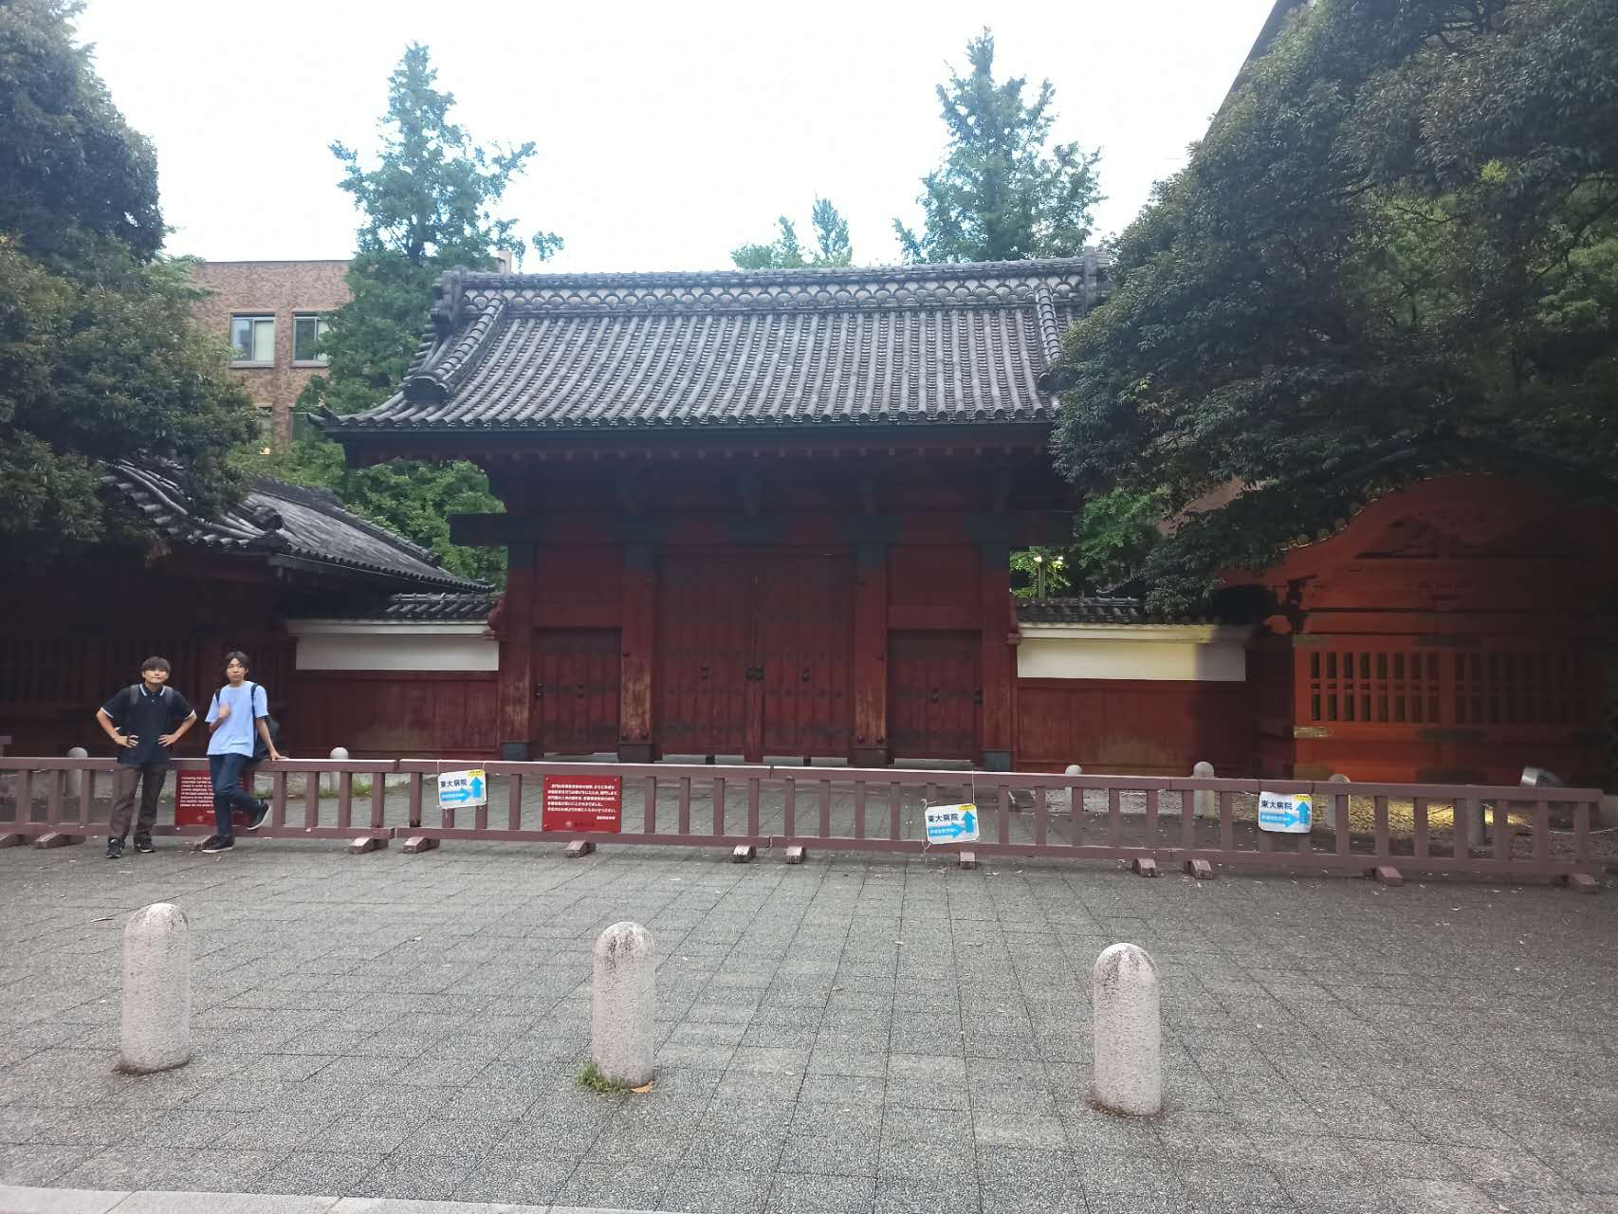
The 22th CNS International Summer School(A3F-CNSSS23)—4~10,August,2023
High precision calculations of nuclear charge radii using Bayesian neural networks
Speaker: Xiao-Xu DONG (董潇旭)
Supervisor: Hao-Zhao LIANG (梁豪兆)
Supervisor: Li-Sheng GENG (耿立升)

Slide 2
Contents
Background
Theoretical framework
Results and discussions
Summary

Slide 3
Contents
Background
Theoretical framework
Results and discussions
Summary

Slide 4
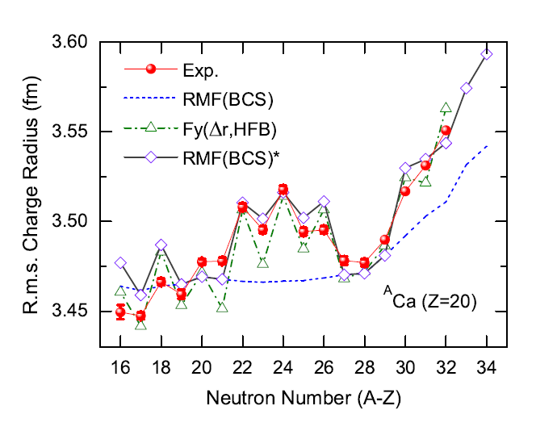
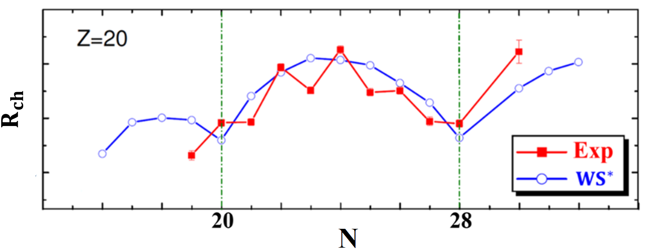
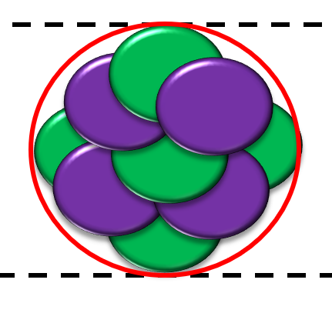
Nuclear charge radii
Nuclear charge radii is one of the most fundamental properties of atomic nuclei which can reflect many interesting phenomena, including neutron skin, neutron halo, proton halo, shape staggering, kinks, odd-even staggering (Ca), …
Phys. Rev. C 102, 024307 (2020).
Phys. Rev. C 88 011301 (2013).
Most challenging
New approaches are needed for better predictions.
Machine Learning(ML)?
Best results so far:
Root-mean-square deviation(RMSD)~0.02fm (1000 data)
<0.02 fm?
Large differences between theoretical results and experimental data.
Notes:
Powerful technique

Slide 5
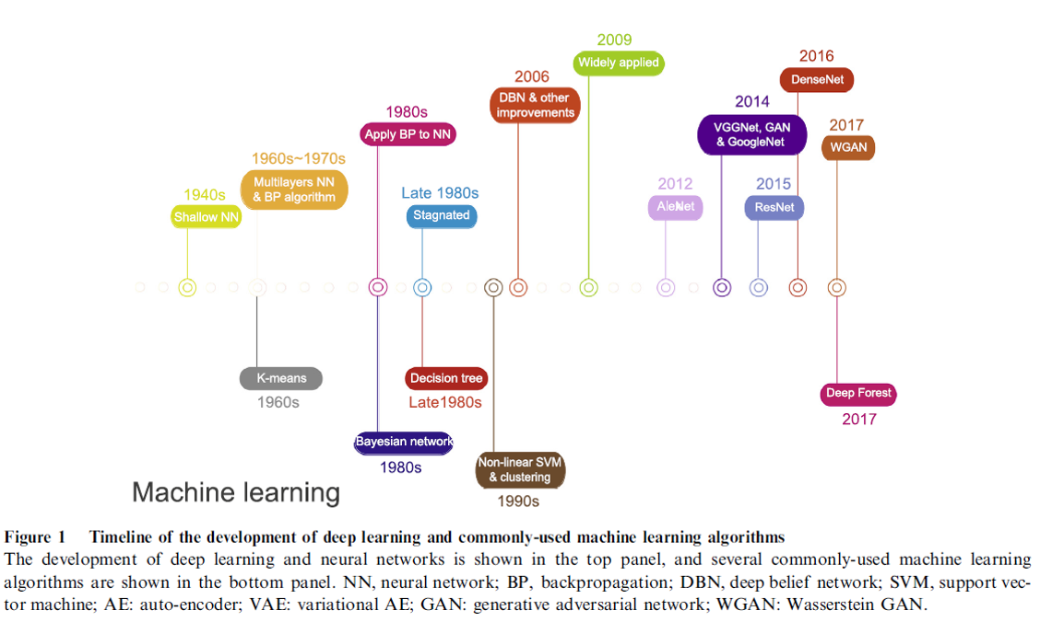
Machine learning(ML)
Genomics, Proteomics & Bioinformatics 16, 17 (2018).
History of development
Data driven:
Learning from data directly without being explicitly programmed.
Early 1990s
Nuclear physics

Slide 6
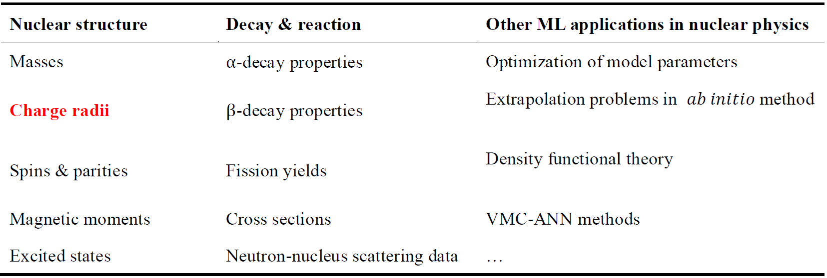
ML in nuclear physics
Recent reviews:
G. Carleo, et al.,Rev. Mod. Phys. 91, 045002 (2019), Machine learning and the physical sciences.
D. Bourilkov, Int. J. Mod. Phys. A 34, 1930019 (2020), Machine and deep learning applications in particle physics.
P. Bedaque et al., Eur. Phys. J. A 57, 100 (2021), A.I. for nuclear physics.
A. Boehnlein et al., Rev. Mod. Phys. 94, 031003 (2022), Colloquium: Machine learning in nuclear physics.
J. E. García-Ramos, et al., arXiv:2307.07332, (2023), Nuclear Physics in the Era of Quantum Computing and Quantum Machine Learning.

Slide 7
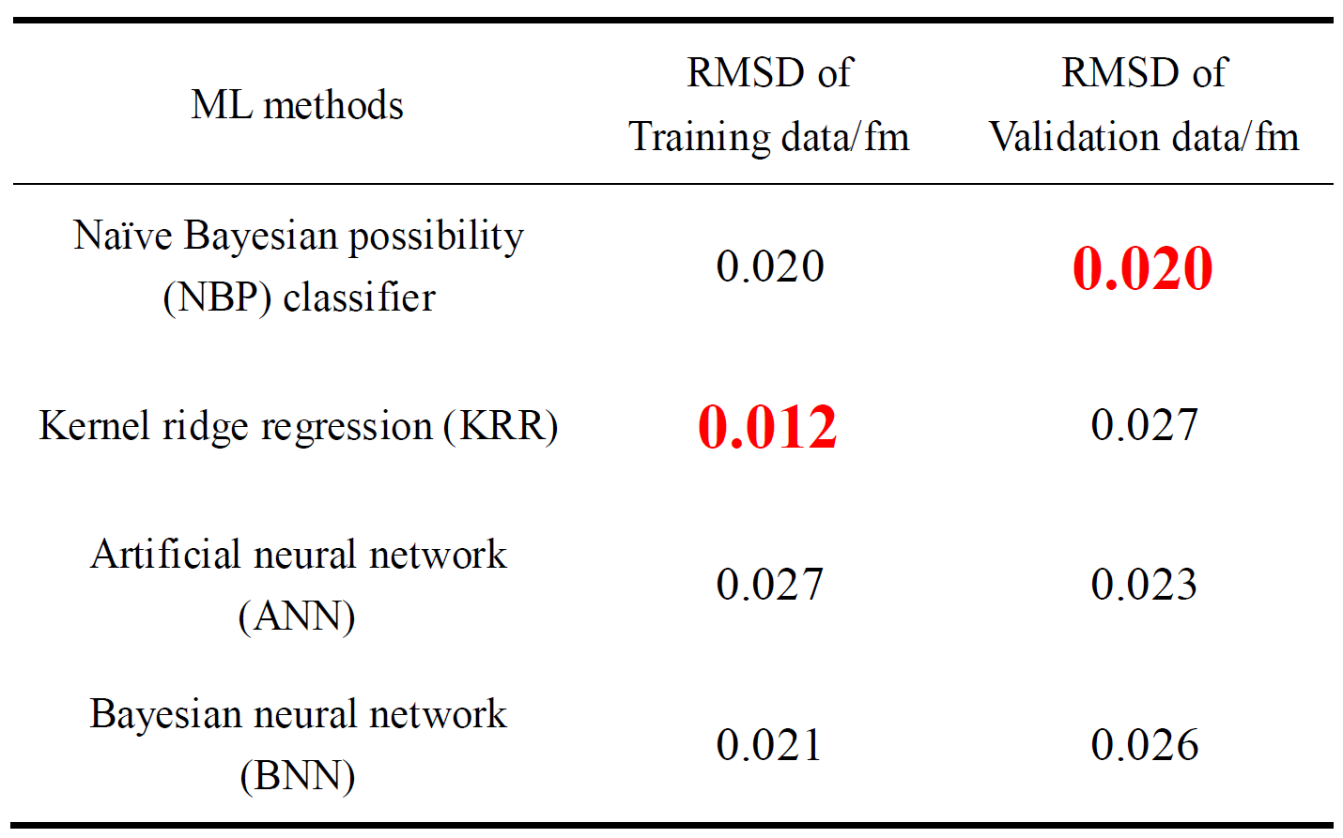
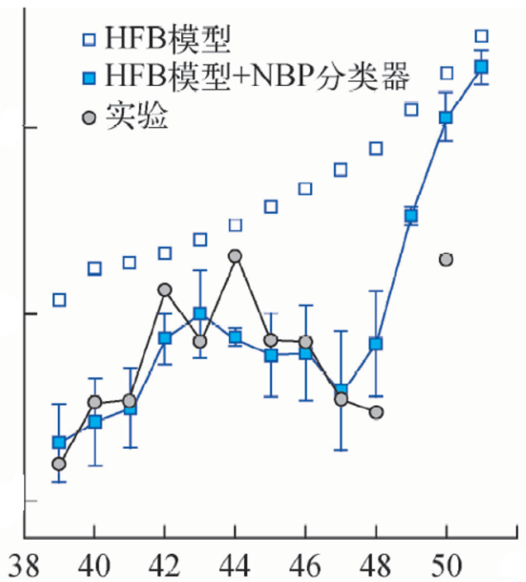
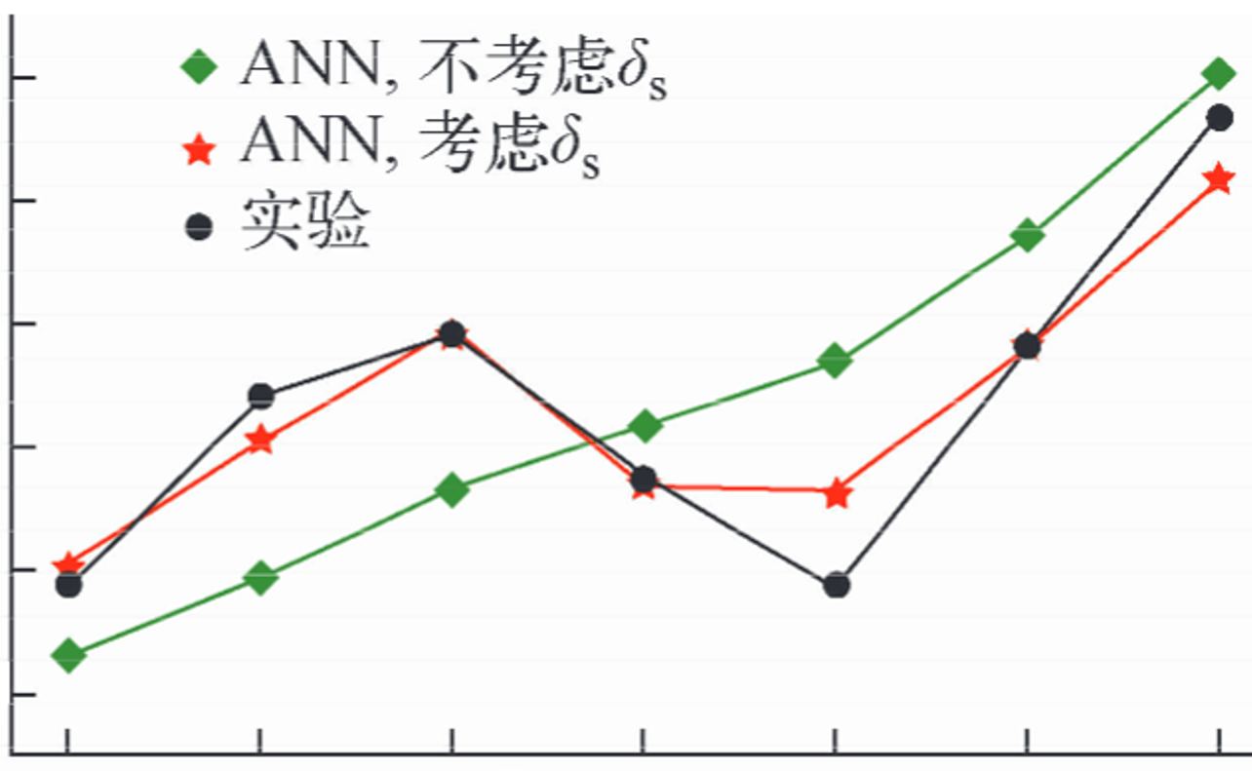
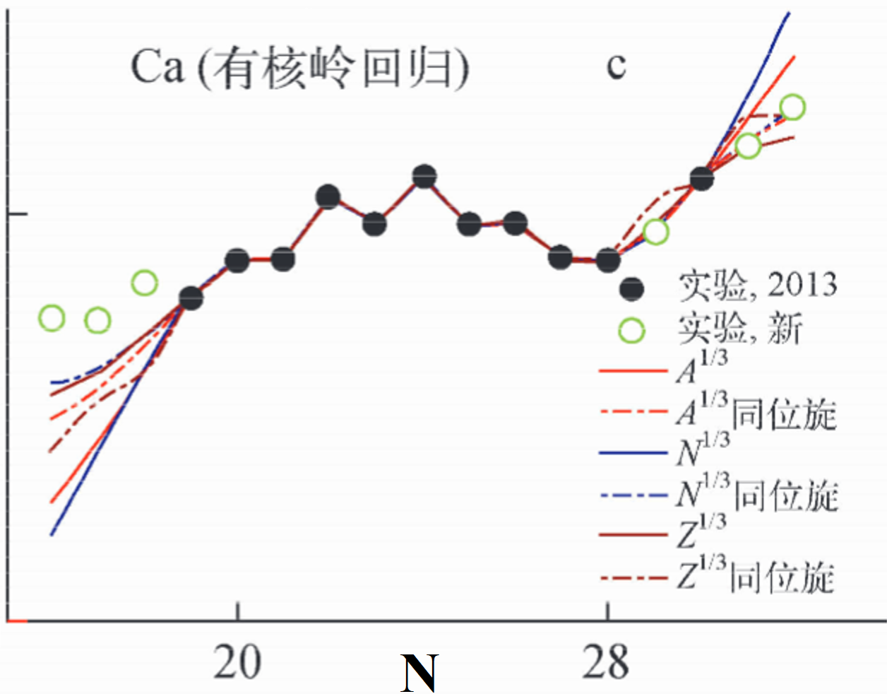
ML in the study of nuclear charge radii
Atomic Energy Science and Technology 57, 679 (2023)
Motivation:
Reduce RMSD
Ca isotopes
Great descriptions
Bad predictions
BNN
KRR
J. Phys. G: Nucl. Part. Phys. 43 114002 (2016)
Notes:
Training for description, validation for prediction

Slide 8
Contents
Background
Theoretical framework
Results and discussions
Summary

Slide 9
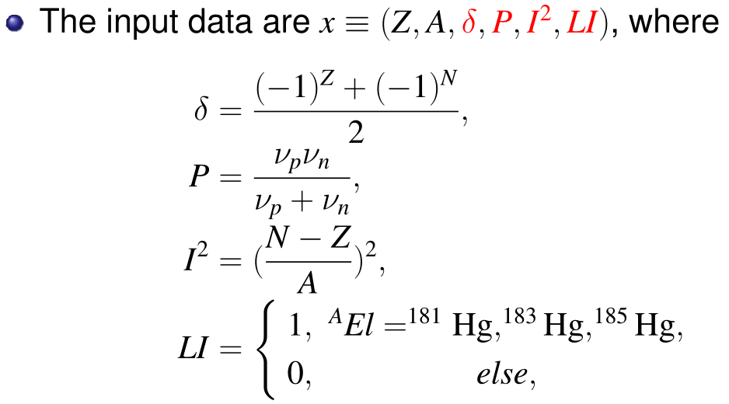
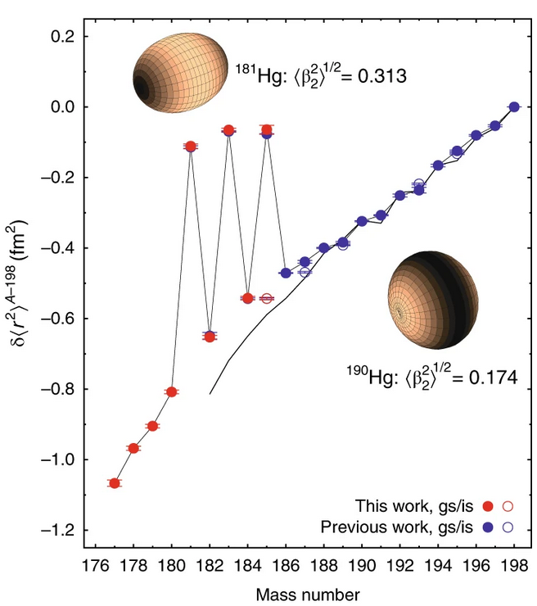
Model constructing (NP-BNN)
Mathematical formula of NN:
Bayesian formula:
Output of BNN:
Nature Phys. 14, 1163 (2018).
Z>19,N>19
Training : 820
At. Data Nucl. Data Tables 99, 69 (2013).
Validation: 113
At. Data Nucl. Data Tables 140, 101440 (2021).
Phys. Rev. Lett. 126, 032502 (2021).
Pairing
Shell
Di: NP-BNNi
D4 :$Z,A,δ,P$ ;
D5 :$Z,A,δ,P,I^{2}$ ;
D6 : $Z,A,δ,P,I^{2},LI$;
Isospin
deformation

Slide 10
Contents
Background
Theoretical framework
Results and discussions
Summary

Slide 11
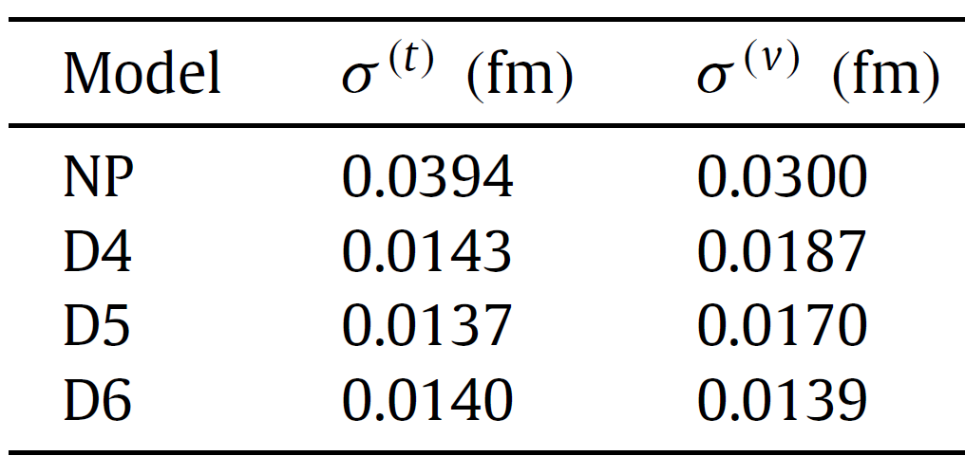
Root-mean-square deviation (RMSD)
Xiao-Xu Dong, et al., Phys. Lett. B 838, 137726. (2023)
$σ_{Di}<0.02$fm,${ σ}_{D6}^{\left(v\right)}\sim 0.014$ fm;
More effective inputs, higher precision;
Stable predictions in different mass region.
Notes:
D4,D5,D6的输入加上

Slide 12
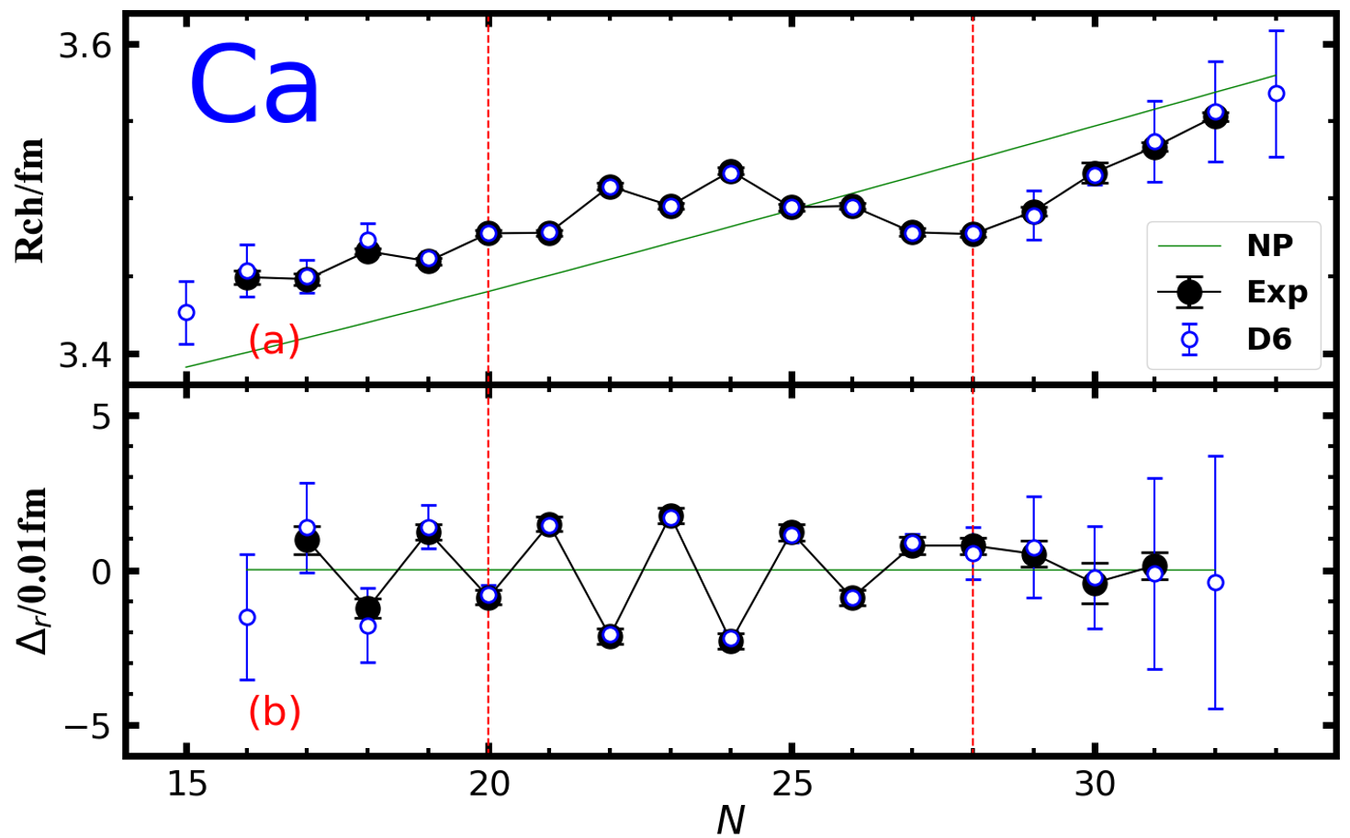
Odd-even staggering (Ca)
Phys. Rev. C 102, 024307 (2020).
Chin. Phys. C 46 , 074105 (2022)
KRR
Especially for predictions in proton-rich area.
Much better than other traditional theories or ML methods.
Results in agreement with experimental data for Ca isotopes.

Slide 13
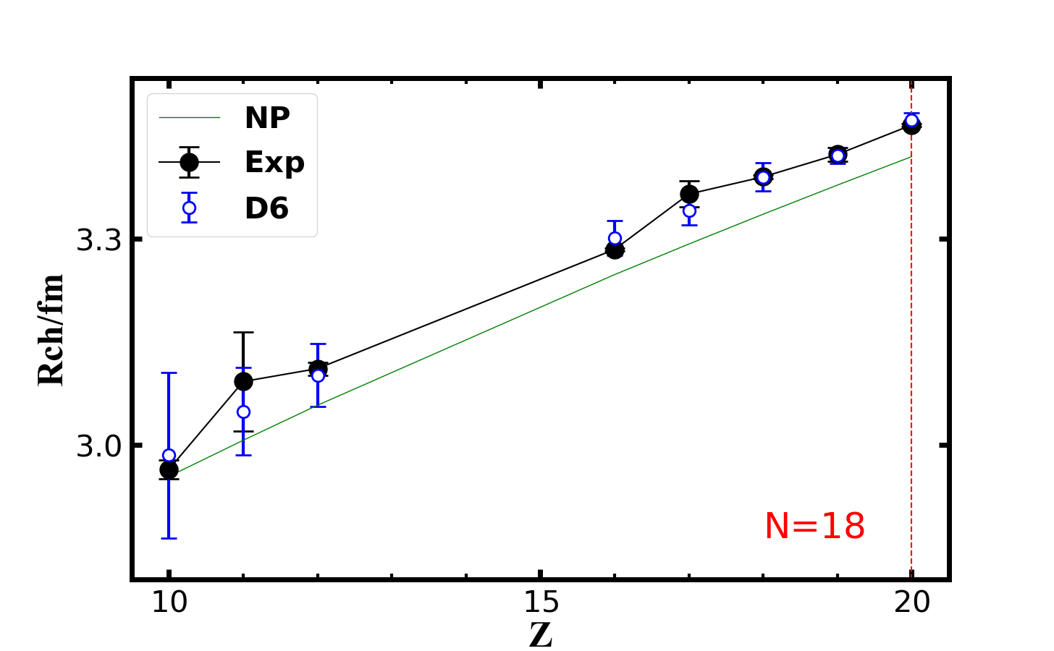
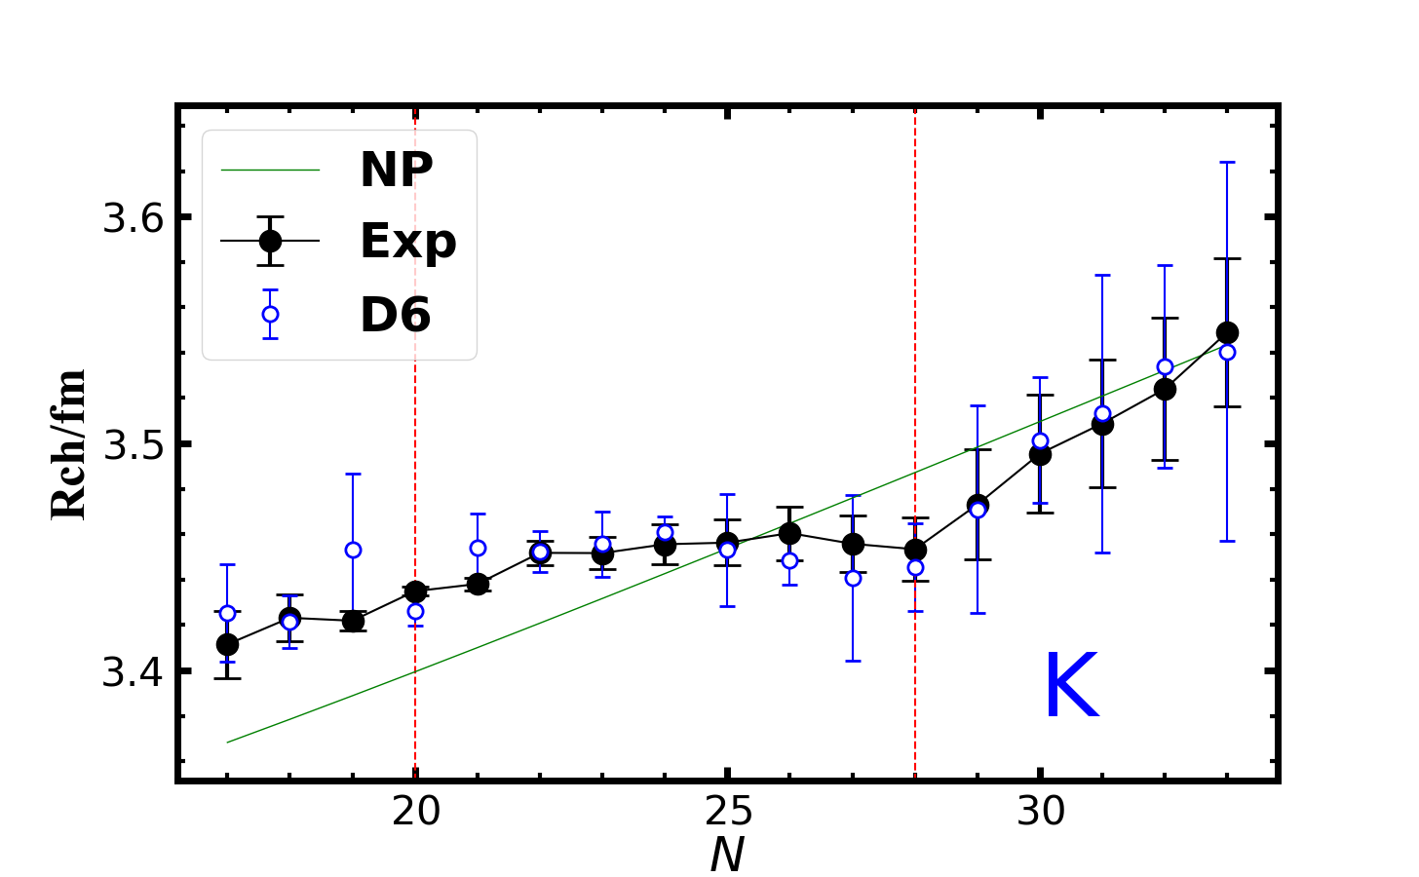
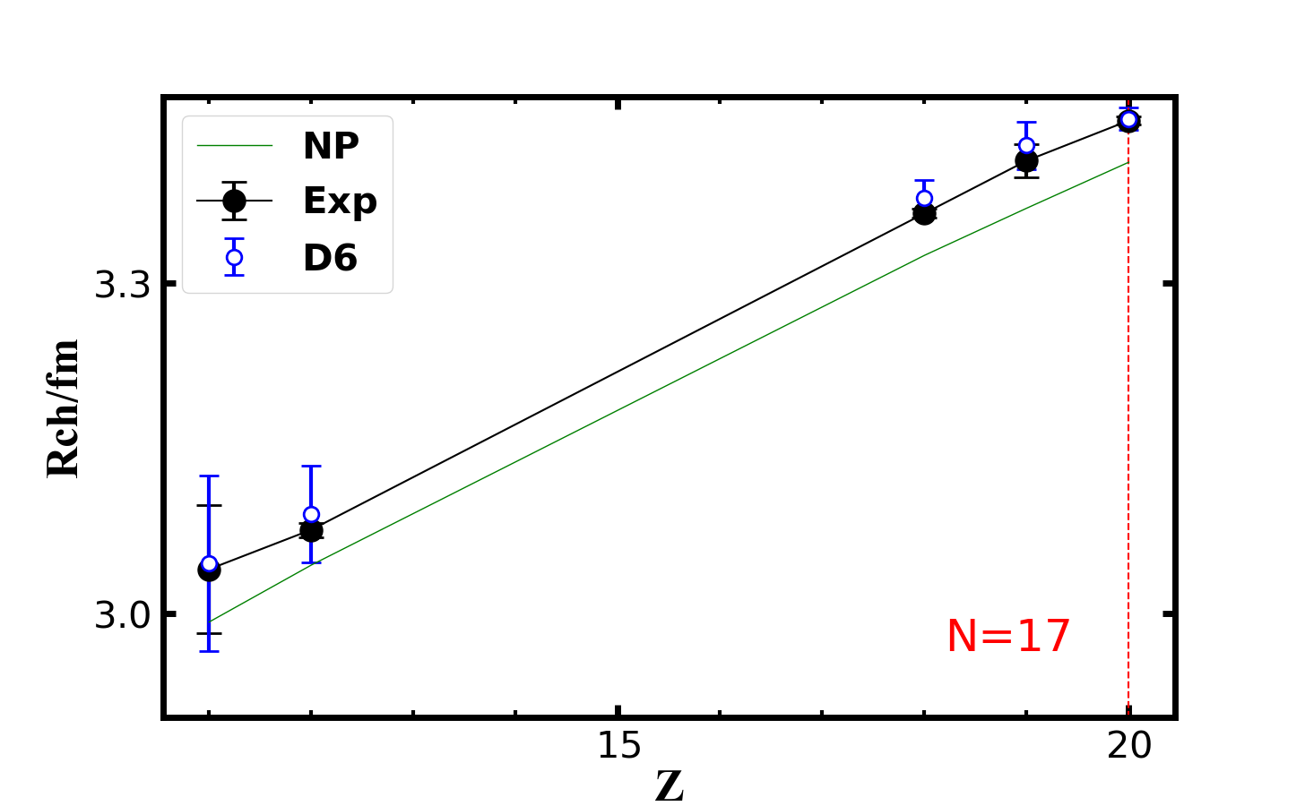
Extrapolation ability
Good predictions of the charge radii for nuclei “far away” from the data set(A$→28$,$ΔA→12$) we use.
Notes:
Thallium，

Slide 14
Contents
Background
Theoretical framework
Results and discussions
Summary

Slide 15
Summary
Construct a NP-BNN6(D6) model, making accurate predictions of nuclear charge radii ($σ$~0.014 fm) and giving accurate predictions for calcium isotopes and lighter isotopic and isotonic chains .
With more effective prior physical information, ML methods can make better predictions when data are not enough.

Slide 16
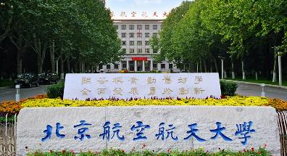
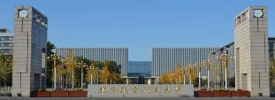
Thanks for your attention！

